Slide 1
Smoking-related lung disease in 3D: not your standard lecture
Dani S. Zander, MD
Professor and Chair, Dept. of Pathology
Penn State College of Medicine/Penn State M.S. Hershey Medical Center, Hershey, PA

Slide 2
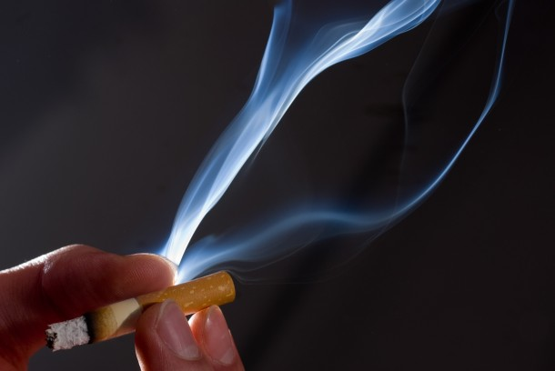
Smoking-Related Lung Diseases
Cause
  Chronic obstructive lung disease (COPD): emphysema, chronic bronchitis, small airway disease
  Lung cancer
Contributor
  Bronchitis and pneumonia
  Asthma
  Some interstitial lung diseases

Slide 3
COPD
In the United States….
  Up to 5% of people are estimated to have COPD
The main symptom is dyspnea (difficulty breathing) and the presence of chronic or recurrent obstruction to airflow in the lung
Major cause of death and disability throughout the world

Slide 4
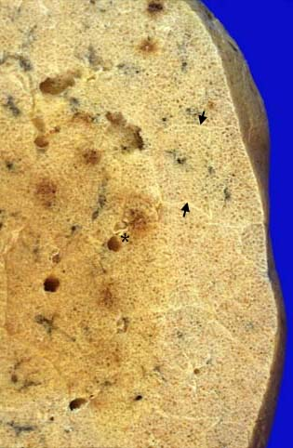
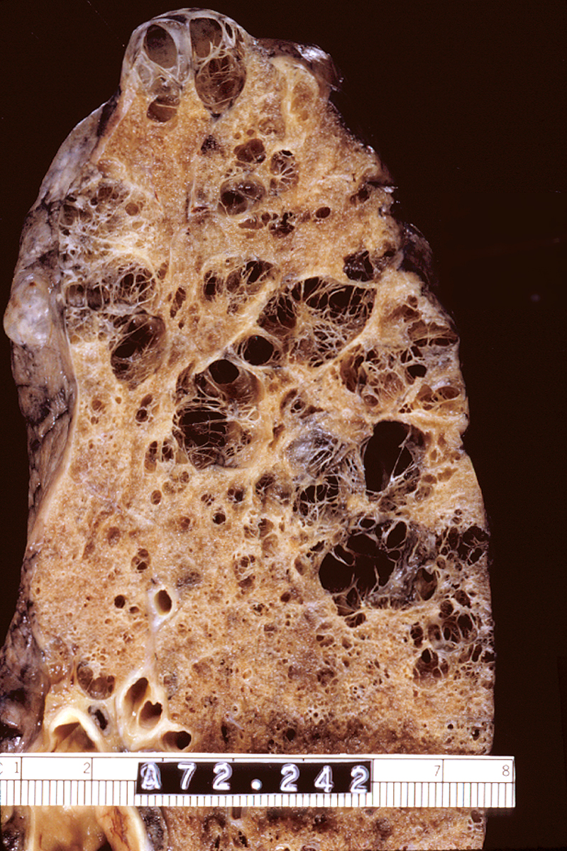
Normal lung
Emphysema
http://pathhsw5m54.ucsf.edu/ctpath/ctpathimages/normdryxx.jpg

Slide 5
Auerbach O, et al. N Engl J Med 1972; 286:853-857.

Slide 6
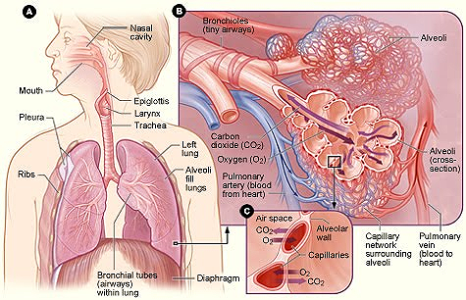
Pathways of inhaled smoke
scienceinterpedia.blogspot.com/2010/05/lungs.html

Slide 7
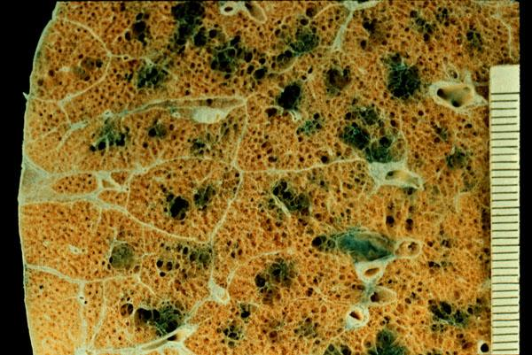
Centriacinar emphysema: enlargement of the central portion of the acinus
The most common type of emphysema and the usual type of emphysema in cigarette smokers
http://www.pathguy.com/lectures/centrilobular.jpg

Slide 8
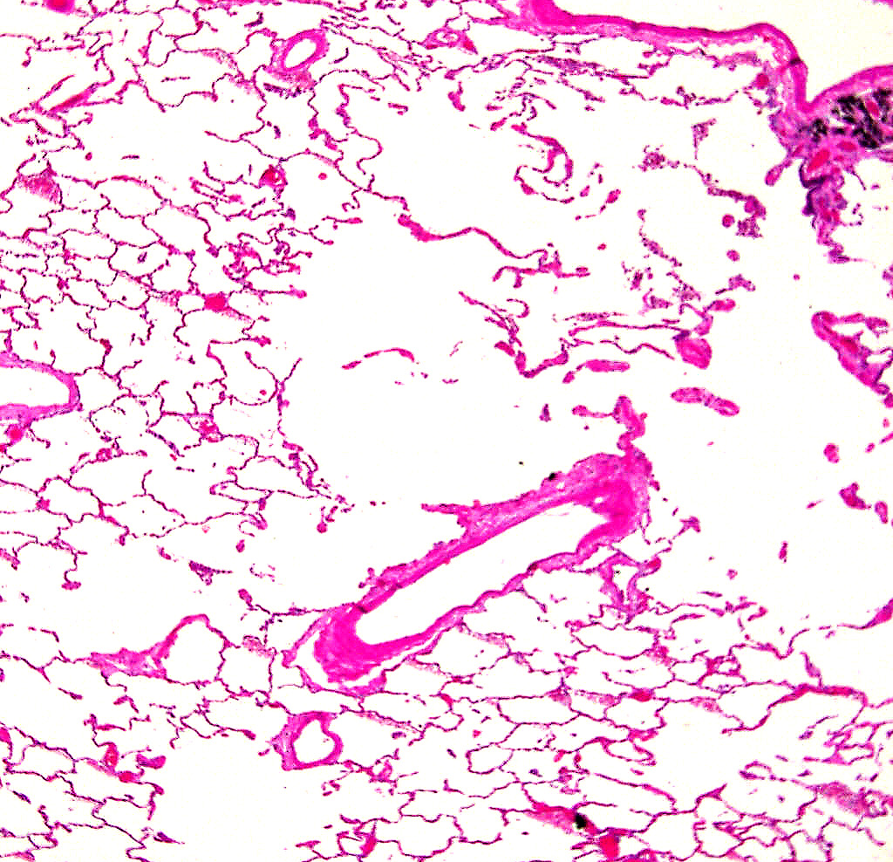
Centriacinar emphysema
Respiratory bronchiole and carbon deposits
Loss (destruction!) of alveolar septa in center of lobule/acinus
Peripheral air spaces look OK

Slide 9
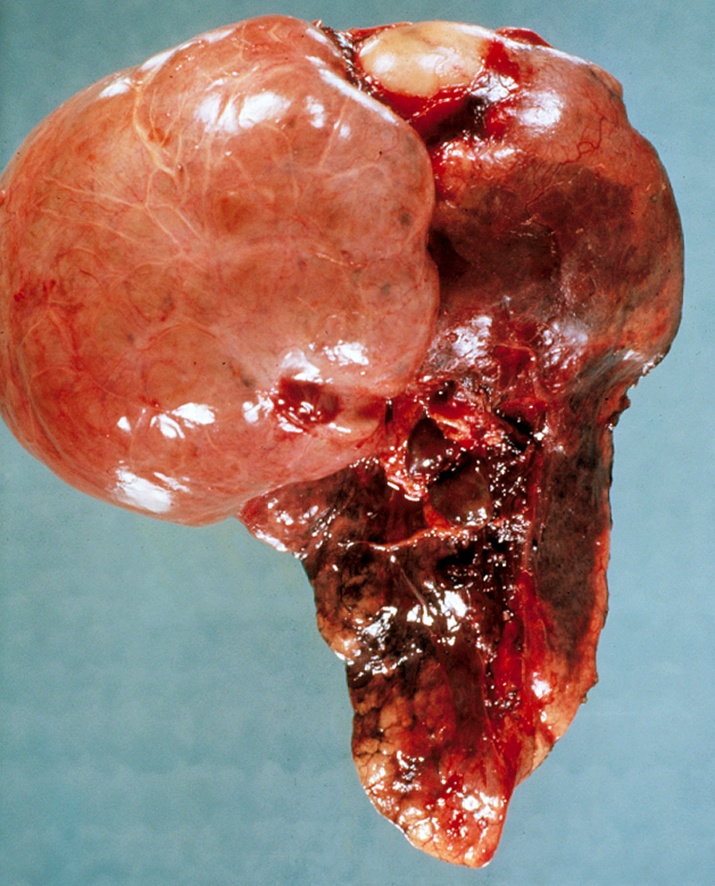
Bullous emphysema

Slide 10
Why does tobacco smoking predispose to emphysema?
Smoke particles → small airways
  → Neutrophils and macrophages (white blood cells) accumulate where the smoke particles land, and release elastase and other proteases → “digestion” of the lung tissues
  → Oxidants (ROS) in smoke and neutrophil granules damage the lung and inhibit antiproteases
    Local destruction of small airways
    Airspace enlargement
    Decreased elastic recoil of the lung and air trapping

Slide 11



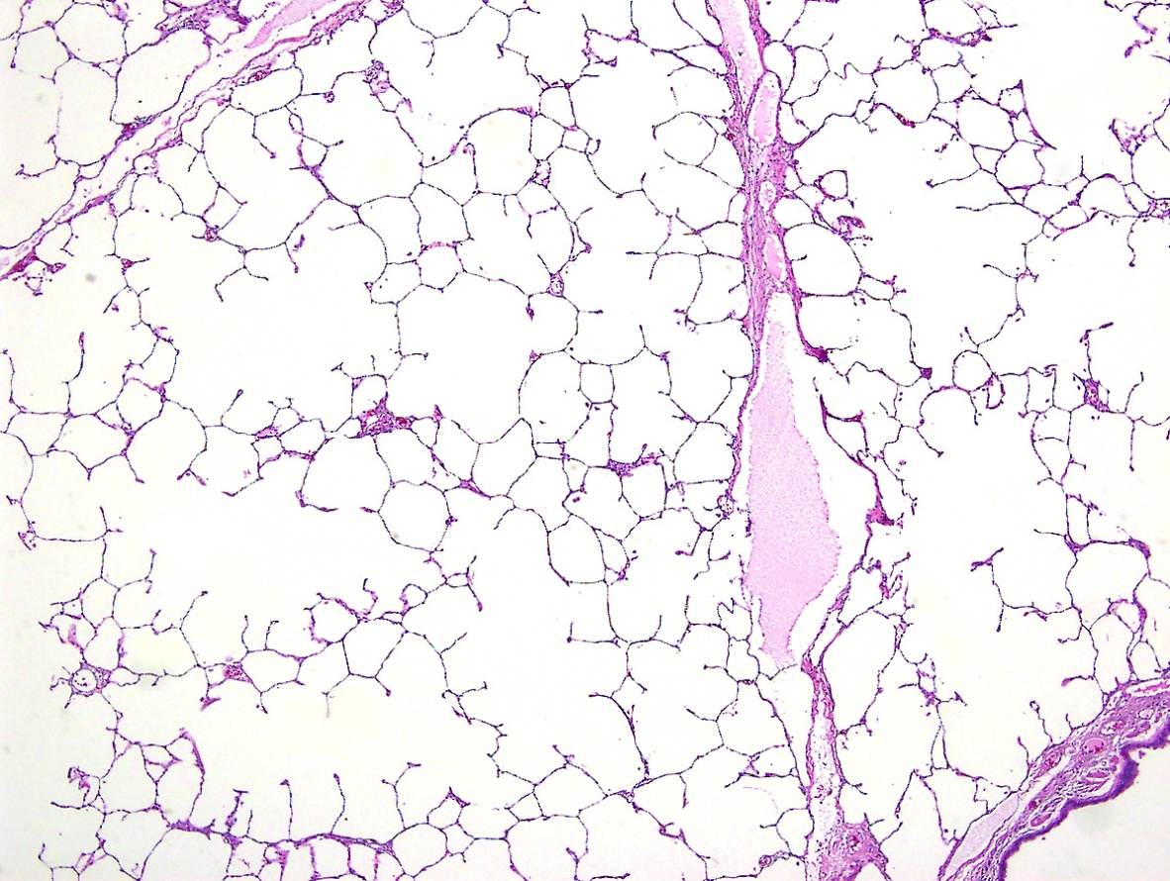
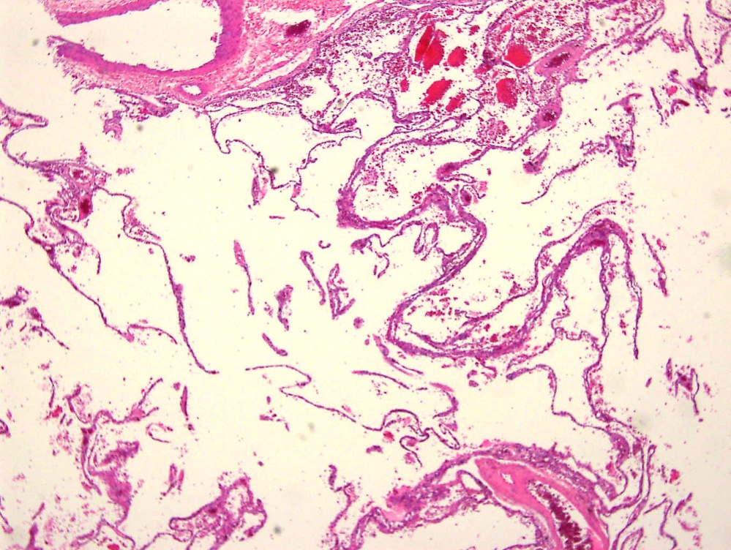
Airway injury leads to decreased elastic recoil and alveolar destruction
Anti-proteases
Proteases

Slide 12
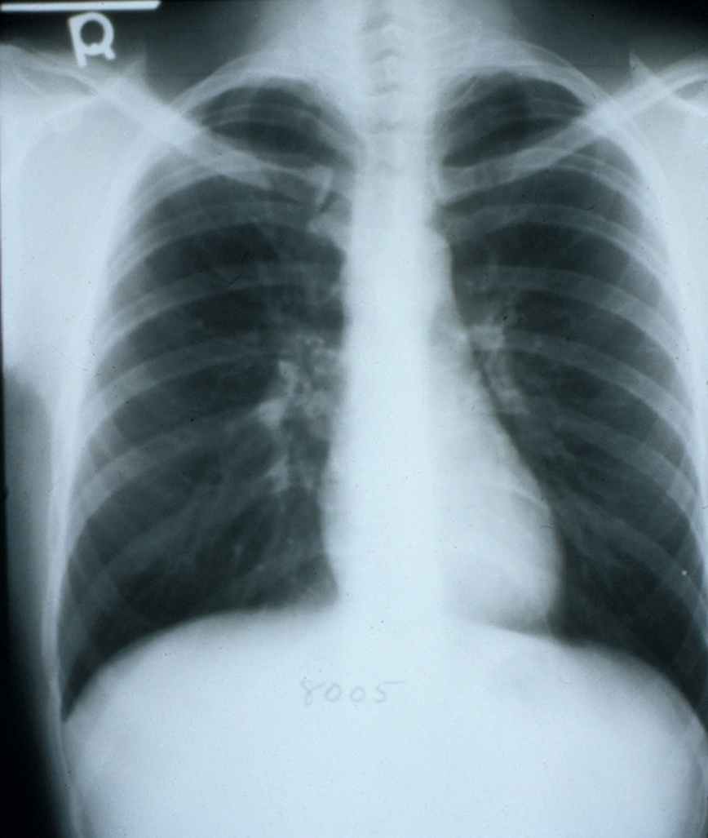
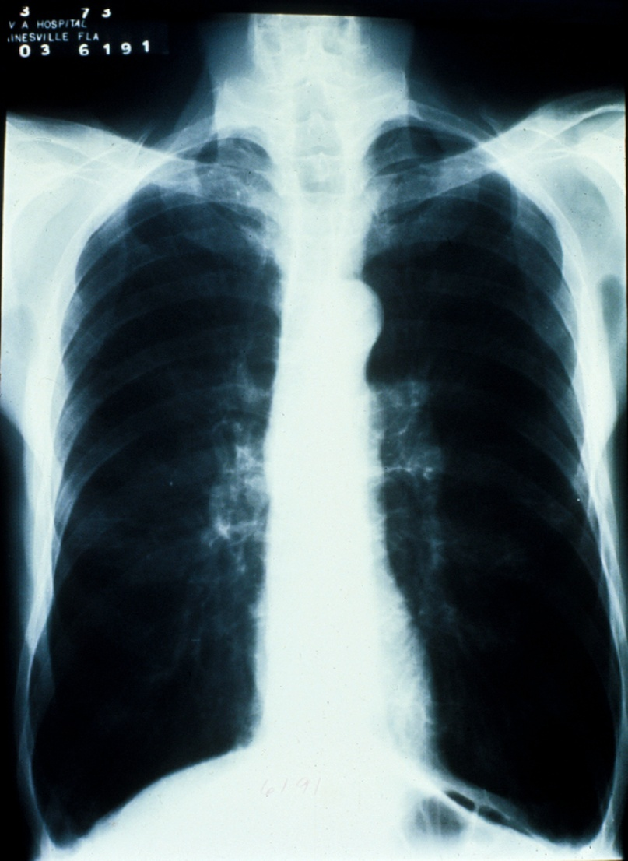
Emphysema
Chest X-ray: hyperinflation, reduced lung markings
Normal
Emphysema

Slide 13
Emphysema: what happens with time
Clinical
  As airways are damaged, gas exchange (oxygen absorbed, carbon dioxide released) becomes compromised, and patients become progressively more short of breath ….. but
  Quitting the habit can STOP progression

Slide 14
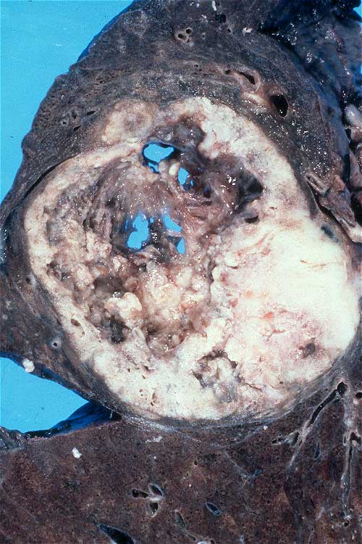
Lung cancer is the leading cause of cancer death in the U.S.
  20% of all cancer deaths in men and 11% in women

Slide 15
Etiology/pathogenesis of lung cancer
Tobacco smoking
Industrial hazards: asbestos, radiation, uranium, etc
Air pollution
Genetic influences
  Variable risk of lung cancer among smokers
  Occasional familial groupings
  Common genetic alterations: C-myc amplification in small cell carcinomas; EGFR, K-ras, or EML4-ALK mutation in adenocarcinomas; loss or inactivation of p53; retinoblastoma gene or genes on the short arm of chromosome 3 in many lung cancers
Scarring
Notes:
1

Slide 16
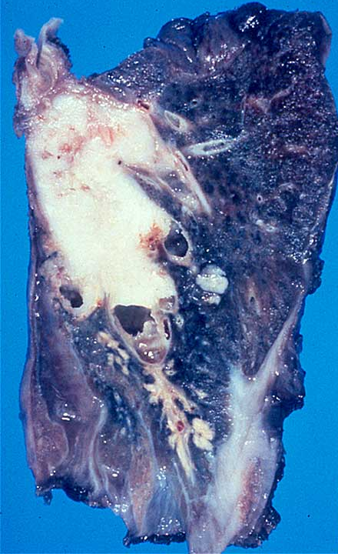
Squamous cell carcinoma
  Highly associated with smoking
  Arises in the large airways (bronchi)
  Grows rapidly and frequently cavitates

Slide 17
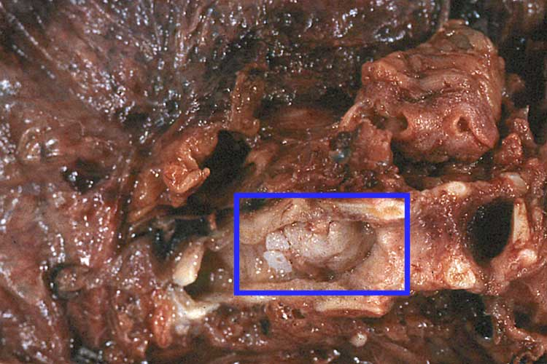

Slide 18
How does normal airway epithelium transform into cancer?
Chemicals in smoke induce ……
A series of genetic and morphologic changes in the cellular composition of airway lining cells (epithelial cells)
Altered cells gain a survival advantage

Slide 19
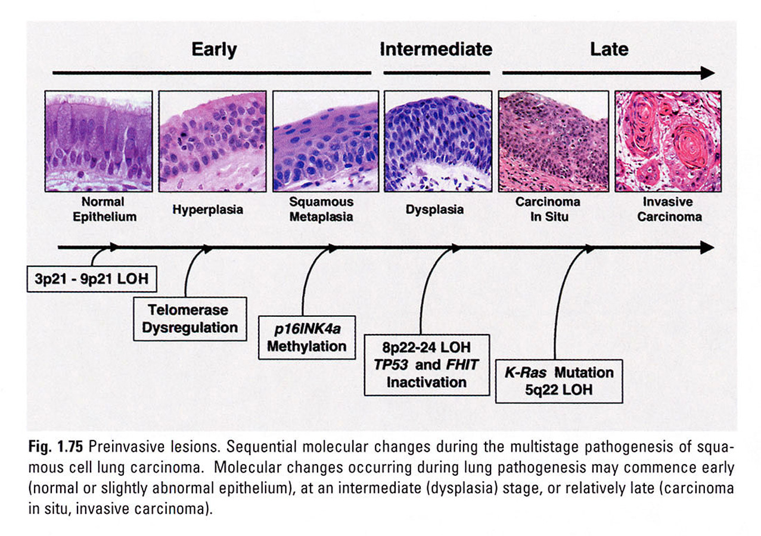
Franklin WA, et al. Squamous dysplasia and carcinoma in situ. In Travis WD, et al. Pathology and Genetics. Tumours of the Lung, Pleura, Thymus, and Heart. Lyon: IARCPress, 2004.

Slide 20
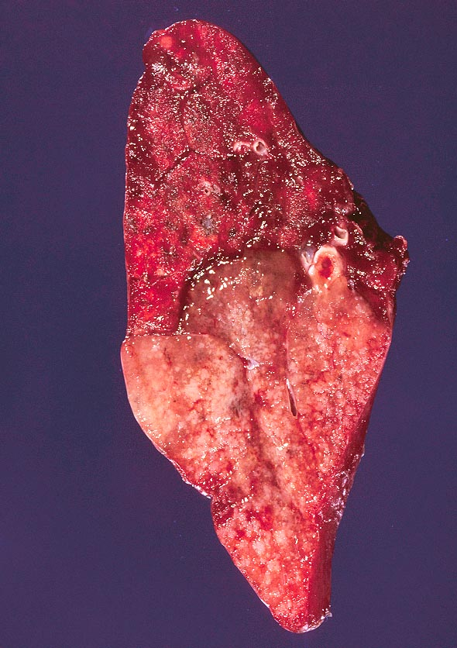
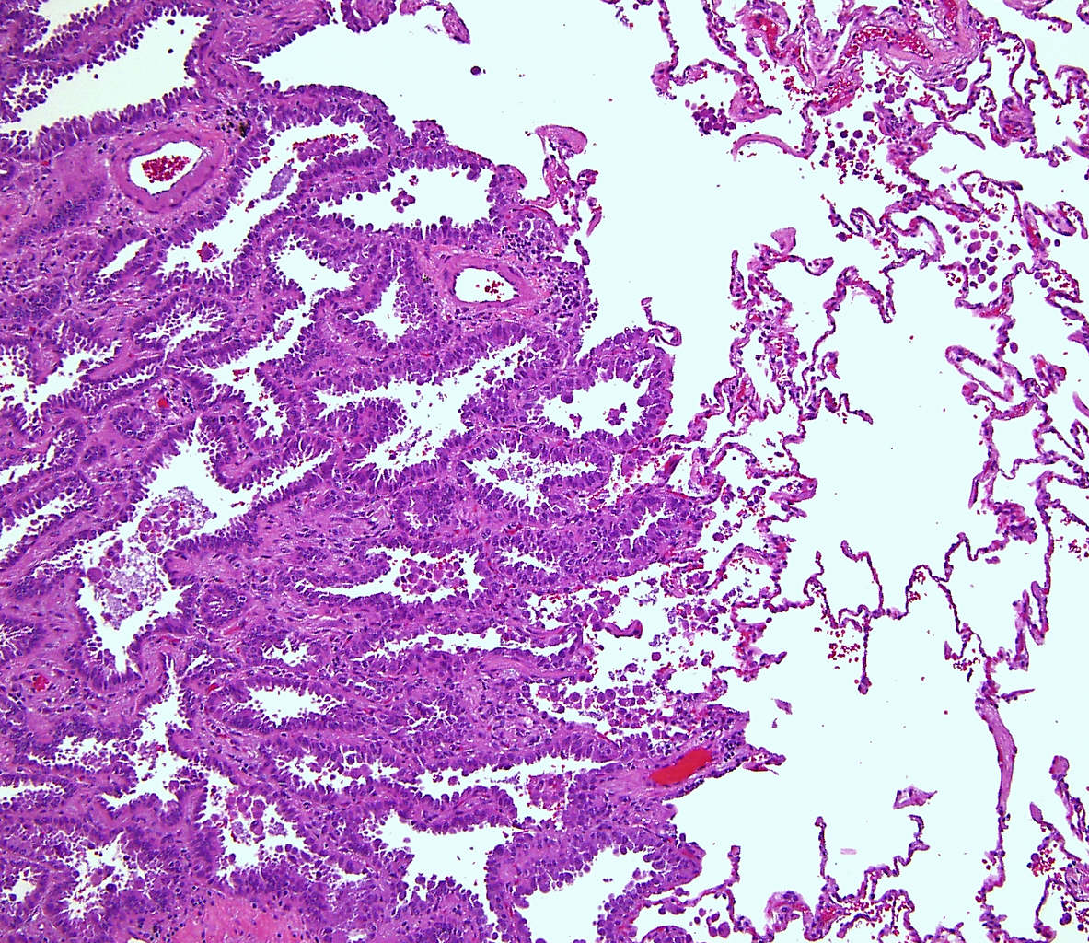
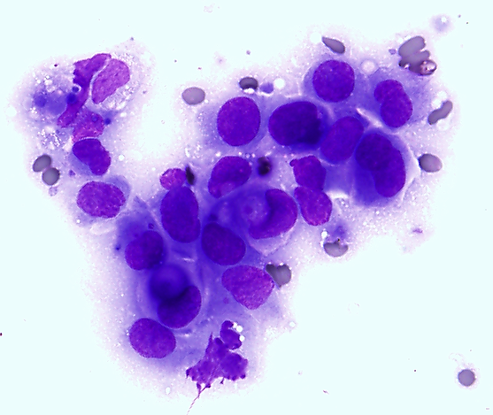
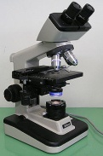
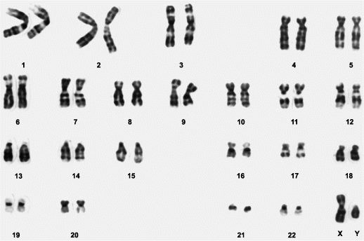
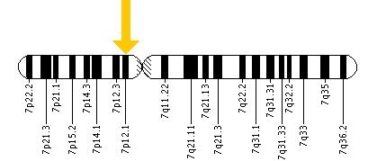
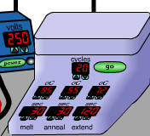
Adenocarcinoma
The epidermal growth factor receptor (EGFR) gene is located on the short (p) arm of chromosome 7 at position 12 (7p12), base pairs 55,086,724 to 55,275,030
10-30% of adenocarcinomas have mutations in the EGFR (epidermal growth factor receptor) gene

Slide 21
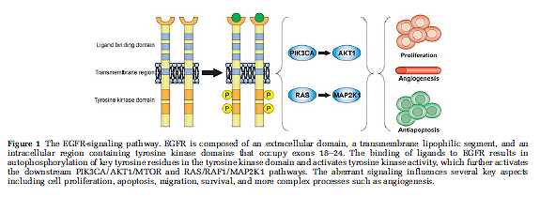
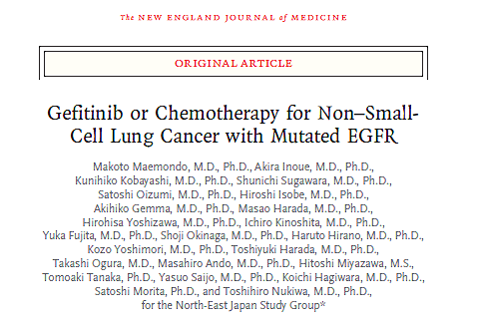
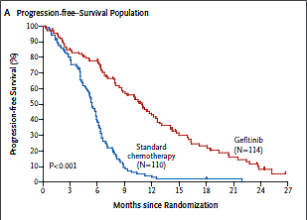
EGFR tyrosine kinase inhibitor response in lung cancer
Cheng L et al, Mod Pathol, 2012
Maemondo M et al, NEJM, 2010

Slide 22
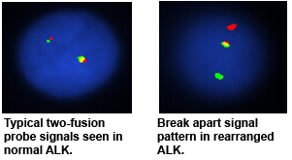
ALK inhibitor response in lung cancer

Slide 23
Acknowledgement
Carlos A. C. Baptista, M.D., M.S., Ph.D., Associate Professor and Director of the Plastination Lab at the Univ. of Toledo
Plastination
  A process that allows preservation of human tissue specimens.
  Water and fat in tissue are replaced with silicone over a period of months. Acetone is used to dehydrate the specimens, which are then placed in a silicone bath until the water and fat in the tissues have been replaced.
  This process removes toxic fixatives and the tissues are believed to be non-infectious.

Slide 24
Instructor
Peter G. Anderson, DVM, PhD
Professor and Director of Pathology Undergraduate Education
Department of Pathology
The University of Alabama at Birmingham

