Slide 1
Scientific Sleuthing of Human Disease for High School Teachers
ASIP 2013 Annual Meeting at Experimental Biology 2013
April 23, 2013
Welcome and Introduction
Mark E. Sobel, MD, PhD
ASIP Executive Officer
ICPI Executive Officer
http://www.asip.org/about/executive_officer.cfm

Slide 2
This presentation is adapted from last year’s Welcome and Introduction by:
Kari Nejak-Bowen
University of Pittsburgh School of Medicine
Department of Pathology

Slide 3

ASIP gratefully acknowledges support from the INTERSOCIETY COUNCIL FOR PATHOLOGY INFORMATION

Slide 4
Workshop Schedule:
9:10 AM Introduction
Mark E. Sobel, ASIP, ICPI
9:30 AM Menacing Microbes: The Threat of Bioterrorism
Martha Furie, Stony Brook University
10:15 AM Break
10:30 AM Stem Cells: Story of Dr. Jekyll and Mr. Hyde
S. Paul S. Monga, University of Pittsburgh
11:15 AM Break
11:30 AM Smoking-Related Lung Disease in 3D: Not Your Standard Lecture
Dani Zander, Pennsylvania State Hershey Medical Center
12:15 PM Tour the Exhibits

Slide 5
What is Pathology?
Pathology is the study and characterization of disease processes.

Slide 6
Pathology incorporates a wide range of disciplines
Genetics
Microbiology
Oncology
Molecular Biology
Bioinformatics
Biochemistry
Pathology
Anatomy
Computational Biology
Surgery
Cell
Biology
Histology
Epidemiology

Slide 7
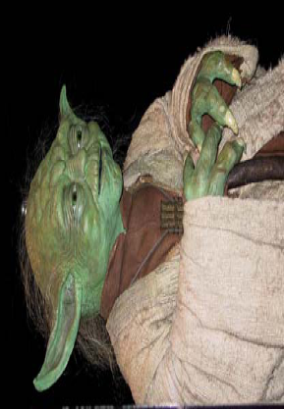
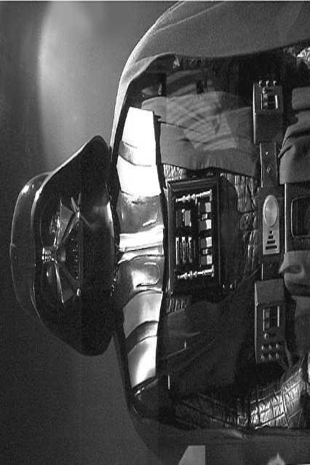
Biology
Pathology
Health
Order
Symbiosis
Homeostasis
Growth
Disease
Disorder
Parasitism
Imbalance
Cancer
Courtesy of Stanley Cohen and Martha Furie

Slide 8

Experimental Pathology…
is a scientific field that investigates the type of injury and the body’s response to it by studying:
  Causes
  Processes
  Development
  Outcomes and consequences

Slide 9
Experimental Pathologists ask:
What causes disease?
How do we know who is at risk for disease?
How do we diagnose disease?
How do we determine prognosis?
How do we understand the nature of the disease?
How do we use our understanding of the disease to develop treatments?

Slide 10
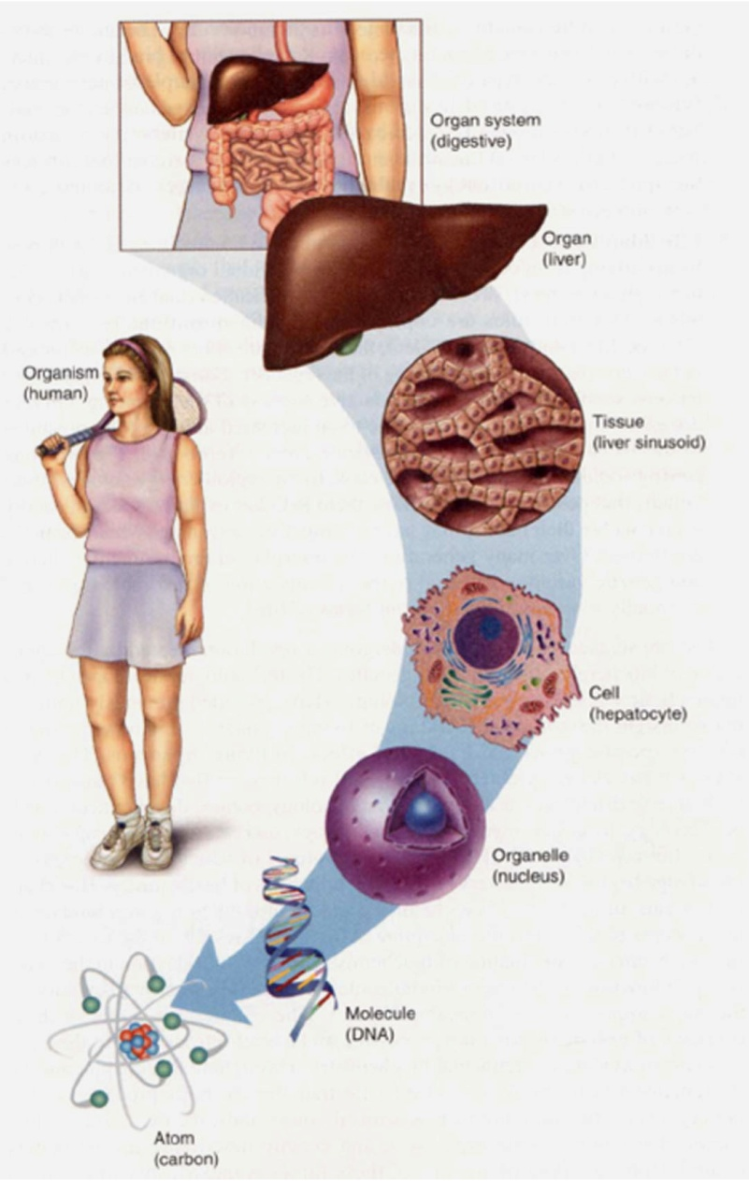
How do pathologists study disease?
Pathology can be studied at the organism, organ, cell, or molecular level
Cell and tissue responses to injury include:
  Injury/inflammation
  Repair/adaptation
  Neoplasia/cancer
redzuannorazlan.blogspot.com

Slide 11
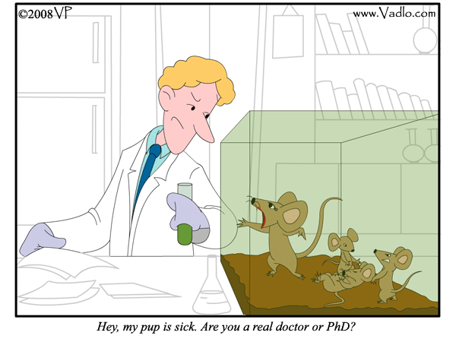
How do pathologists study disease?
Experimental pathologists often use cells grown in the laboratory to study the initiation and progression of disease.
Animal models are also used to study the effect of a disease on the entire body or when in vitro methods are not technologically feasible.

Slide 12
Animal Rights vs. Animal Welfare
Animal rights is the term used to describe the belief that animals are entitled to legal rights and people should not interfere with their lives. Proponents of animal rights oppose eating animals, wearing fur, leather, or silk, and using animals in research.
Animal welfare refers to the belief that we must treat animals with respect and compassion, but the needs of humans should be balanced with those of animals.
Integrating the Life Sciences from Molecule to Organism

Slide 13
Animal research misconceptions
“We don’t need animal research”
“Research is animal abuse”
“No one looks out for the animals”
“Treatments developed in animals don’t work on people”
Integrating the Life Sciences from Molecule to Organism

Slide 14
1. “We don’t need animal research”
Expressions of this view include:
  Scientists could get answers without animals if they tried hard enough.
  We have computers and cell cultures so why do scientists still study animals?
Integrating the Life Sciences from Molecule to Organism

Slide 15
Response:
Animal research remains necessary
Animal research is an integral part of the search for cures.
We have to understand basic biology to learn how to treat/cure disease.
Animals are used along with computer models, cell cultures and human studies.
The research model needed depends upon the scientific question.
Integrating the Life Sciences from Molecule to Organism

Slide 16
2. “Research is animal abuse”
What animal rights groups say:
  “cruel and useless”; “irrelevant and deadly” (PETA)
  “deliberately sickened… and the killed” (HSUS)
  “burnt, crushed, sliced, electrocuted, poisoned with toxic chemicals, and psychologically tormented” (Last Chance for Animals)
Integrating the Life Sciences from Molecule to Organism

Slide 17
Response:
Animal research is humane
People want the benefits of biomedical research, but they will support research if and only if they are confident that animals are treated humanely.
Accusations of mistreatment undermine public confidence.
Integrating the Life Sciences from Molecule to Organism

Slide 18
Response:
Animal research is humane
Research is highly regulated, and researchers are committed to animal welfare.
Animal welfare is important in its own right, but it is also essential to good science.
Veterinarians and skilled animal care technicians are part of the research team.
Integrating the Life Sciences from Molecule to Organism

Slide 19
3.“No one looks out for the animals”
Researchers “think they can do whatever they want” to animals
  Anonymous posting from http://www.debate.org/opinions/do-non-human-animals-have-rights
“No experiment, no matter how painful or trivial, is prohibited”
  PETA, http://www.peta.org/issues/animals-used-for-experimentation/animal-testing-bad-science.aspx
Integrating the Life Sciences from Molecule to Organism

Slide 20
Response: Researchers care about animal welfare
People want to know that animals are treated humanely.
The public wants to know that someone is looking out for the animals.
Integrating the Life Sciences from Molecule to Organism

Slide 21
Response: Researchers care about animal welfare
An Animal Care and Use Committee at each institution rigorously reviews all proposed studies.
Veterinarians help design protocols.
Animals get care from skilled technicians and veterinarians.
Integrating the Life Sciences from Molecule to Organism

Slide 22
Response: Researchers care about animal welfare
Most research is not painful.
If an animal is in pain, pain medication must be given unless this would interfere with the research.
Studies must have defined endpoints. In an animal is suffering, it will be removed from the study or euthanized.
Integrating the Life Sciences from Molecule to Organism

Slide 23
4. “Treatments developed in animals don’t work on people”
Response: Animal Research Advances Both Animal and Human Welfare
Integrating the Life Sciences from Molecule to Organism

Slide 24
Response: Animal Research Advances Both Animal and Human Welfare
An “animal model” of disease displays a biological response similar to humans so potential treatments can be tested on them.
Sometimes scientists want to find animals that aren’t susceptible to a disease because the reason for that resistance may also lead to new treatments.
Integrating the Life Sciences from Molecule to Organism

Slide 25
Response: Animal Research Advances Both Animal and Human Welfare
There are many similarities in how cells and organs work in warm-blooded animals.
For that reason, many of the same drugs (antibiotics, pain relievers, etc.) are prescribed to humans and animals.
If a species has a different response to a drug, that can provide clues about how the drug works.
Integrating the Life Sciences from Molecule to Organism

Slide 26
Assurances about Animal Research
Most people will support animal research if they have assurances that it is:
  Appropriate Scientifically necessary
  Beneficial Advances health
  Caring Conducted humanely
Integrating the Life Sciences from Molecule to Organism

Slide 27
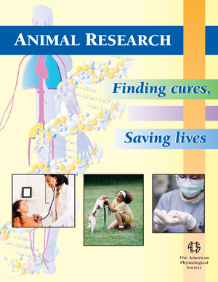
Animal Research Information
Animal Research Cures (APS) http://www.animalresearchcures.org/Advocacy.htm
Americans for Medical Progress http://www.amprogress.org/advocacy
Integrating the Life Sciences from Molecule to Organism

Slide 28
Why teach pathology in high school?
Relevant and timely
  Our understanding of disease is becoming more advanced.
  Health care is also becoming more complex.
  Almost half of all Americans (90 million) are burdened with limited health literacy.
  There is a wealth of misleading information on health and disease topics.
Real-world application of science
  Many students have been affected by disease in their daily lives.
Rewarding and interesting
  Knowing more about their own health and bodies can empower students.

Slide 29
What pathology-related topics are high school students interested in learning more about?
Most Interested
Least Interested
AIDS
Cancer*
Genetic testing
Stem cells*
Biological warfare*
Allergies
Arthritis
Asthma
Tobacco
Obesity
Special thanks to Jaime Bhalla and Martha Furie

Slide 30
Finding information on pathology-related topics
The internet is a great resource for both teachers and students:
  Much of pathology is visual
  Pictures and examples will catch the attention of students
  A great self-learning tool, where students can progress at their own pace
  Opportunity for independent investigation
2 ways to find information about pathology:
  Internet search engines
  Health and patient education web sites

Slide 31
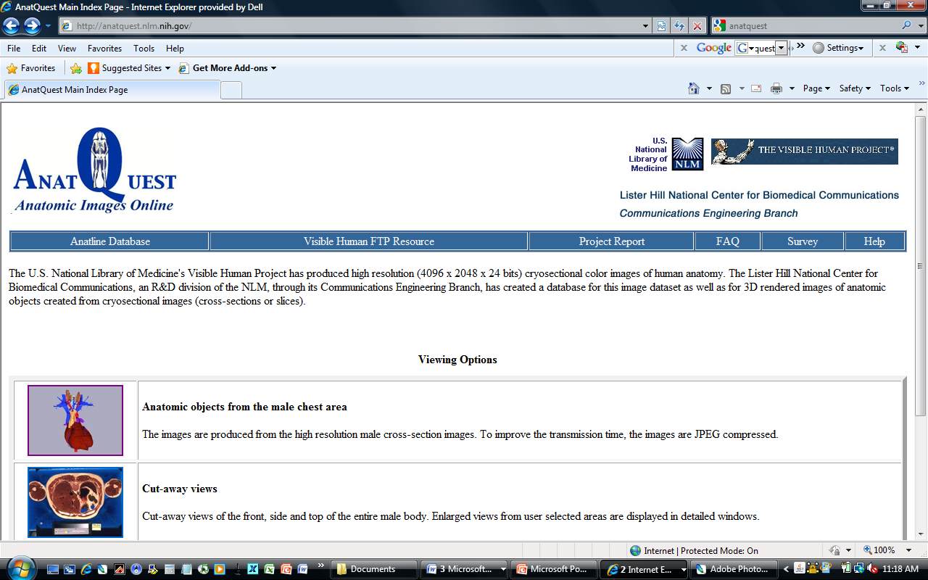
Anatquest, an NIH-sponsored site for anatomic images
http://anatquest.nlm.nih.gov/

Slide 32
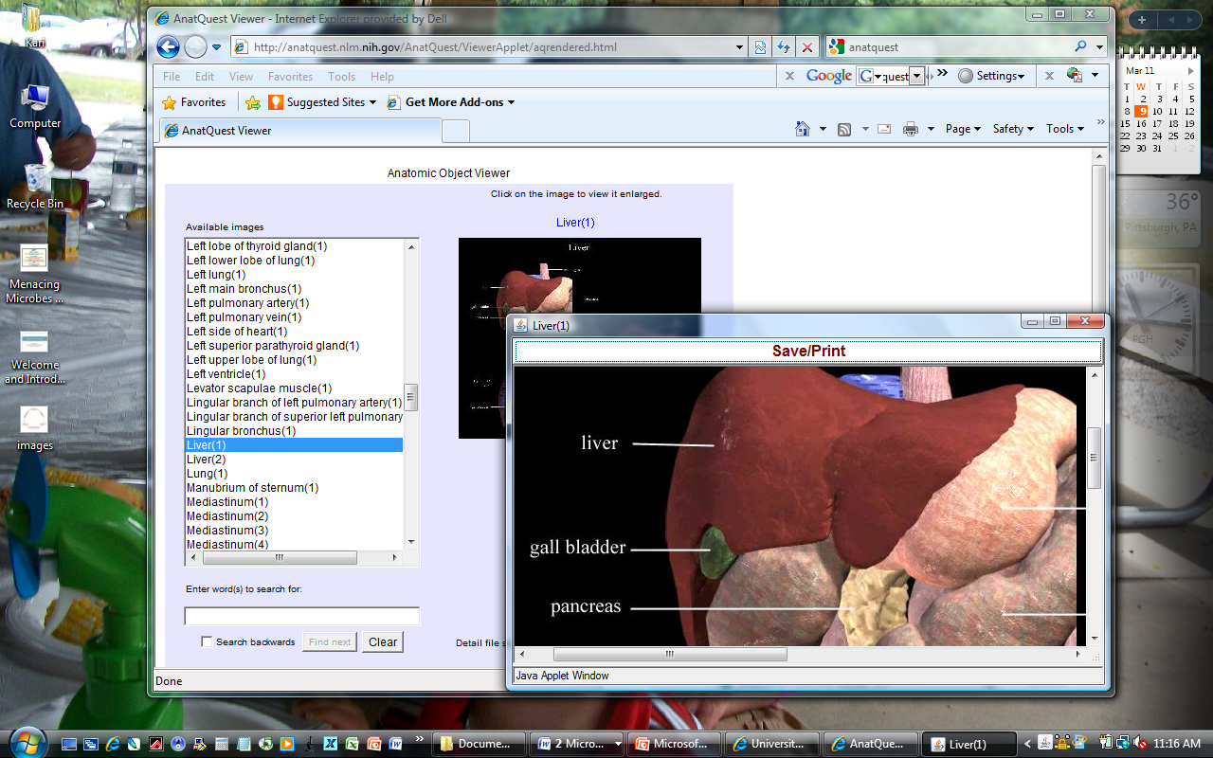
Anatquest anatomical viewer

Slide 33
Webpath, a website containing images and descriptions of diseases and pathologic conditions
http://library.med.utah.edu/WebPath/webpath.html

Slide 34
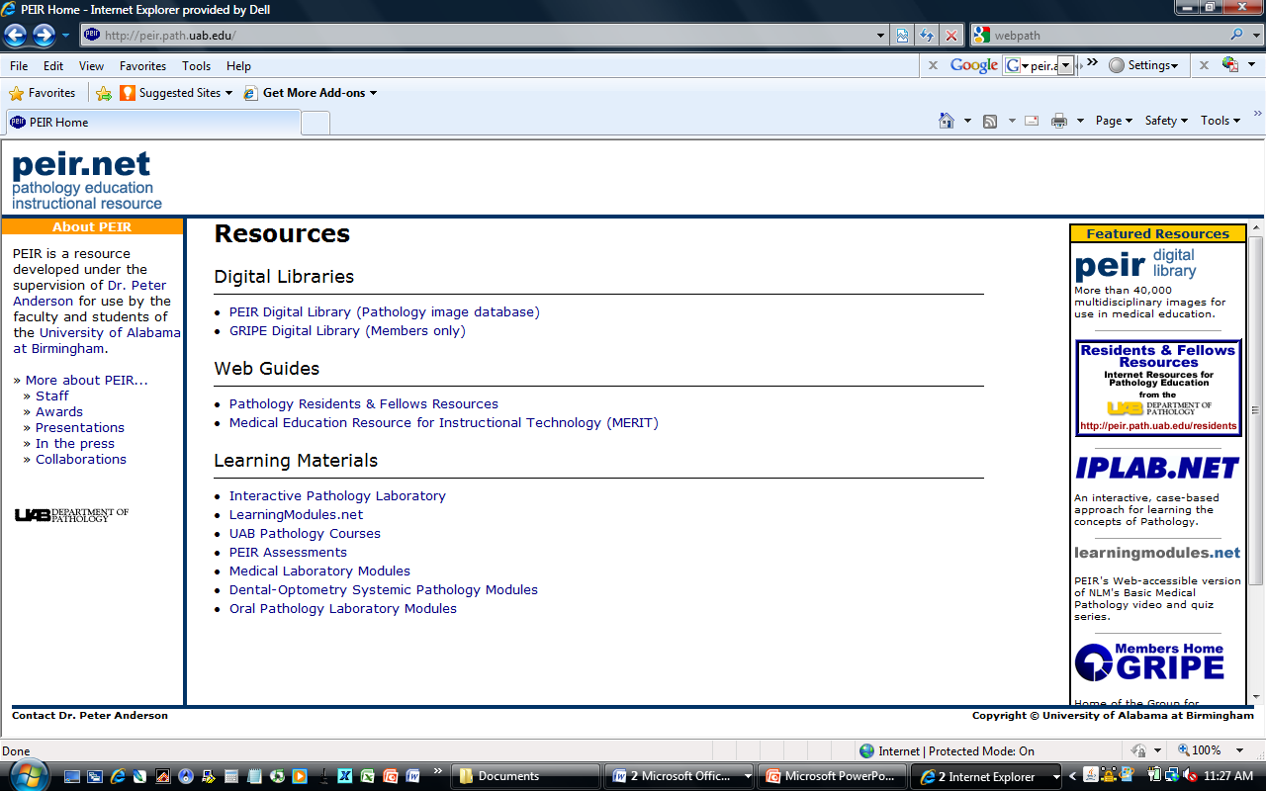
PEIR, another pathology-related educational resource
http://peir.path.uab.edu/

Slide 35
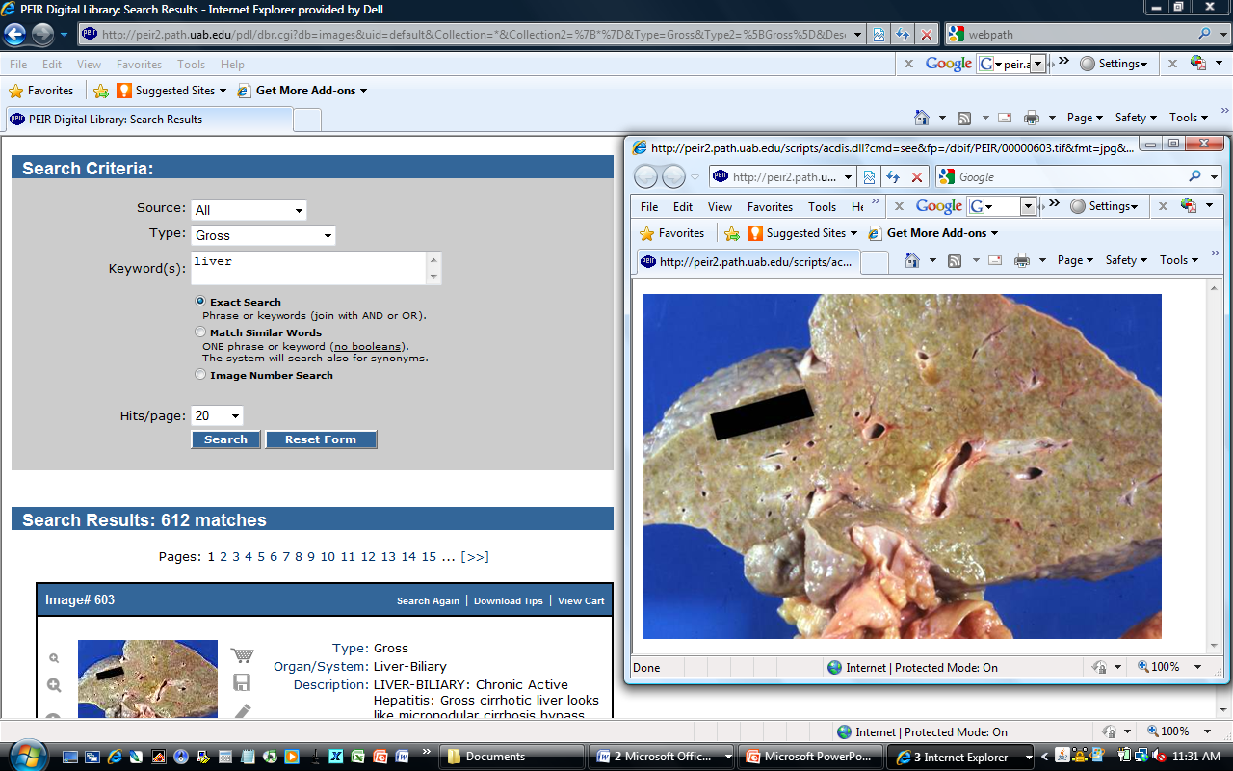
Searching the PEIR database

Slide 36
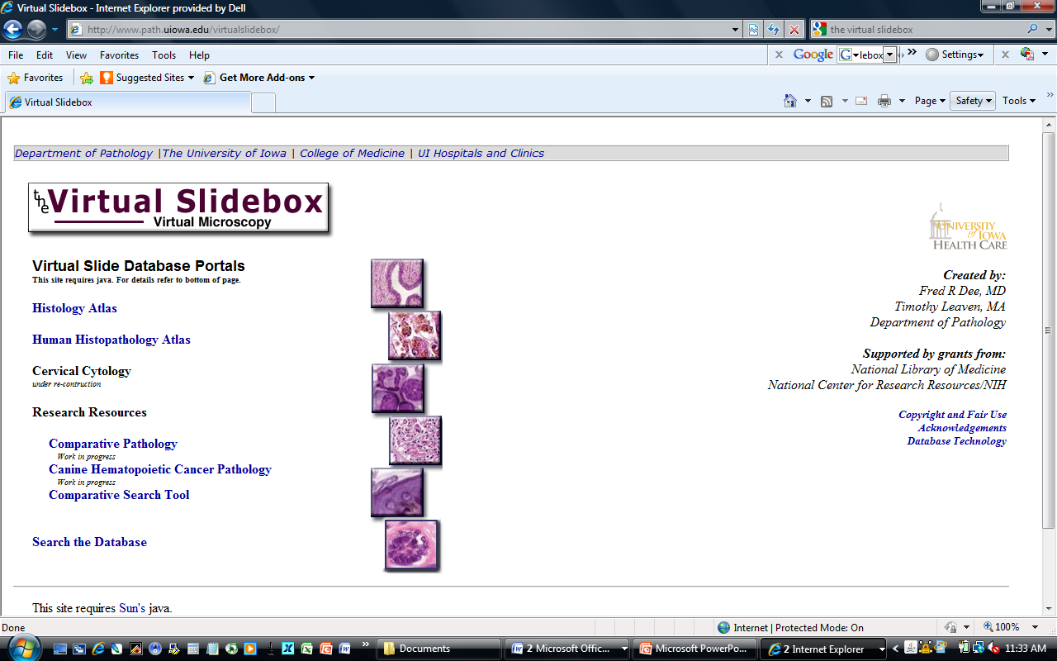
The Virtual Slidebox shows images of tissues microscopically
http://www.path.uiowa.edu/virtualslidebox/

Slide 37
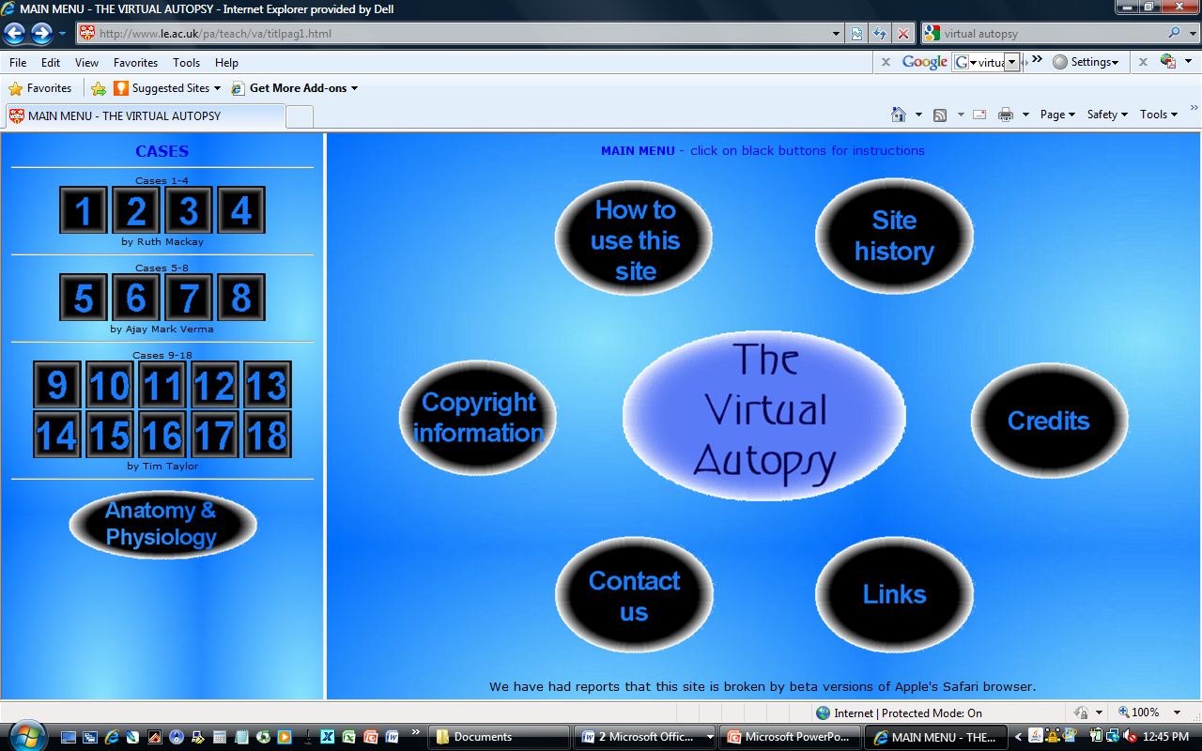
Virtual Autopsy is an interactive experience that allows students to diagnose cases
http://www.le.ac.uk/pa/teach/va/welcome.html

Slide 38
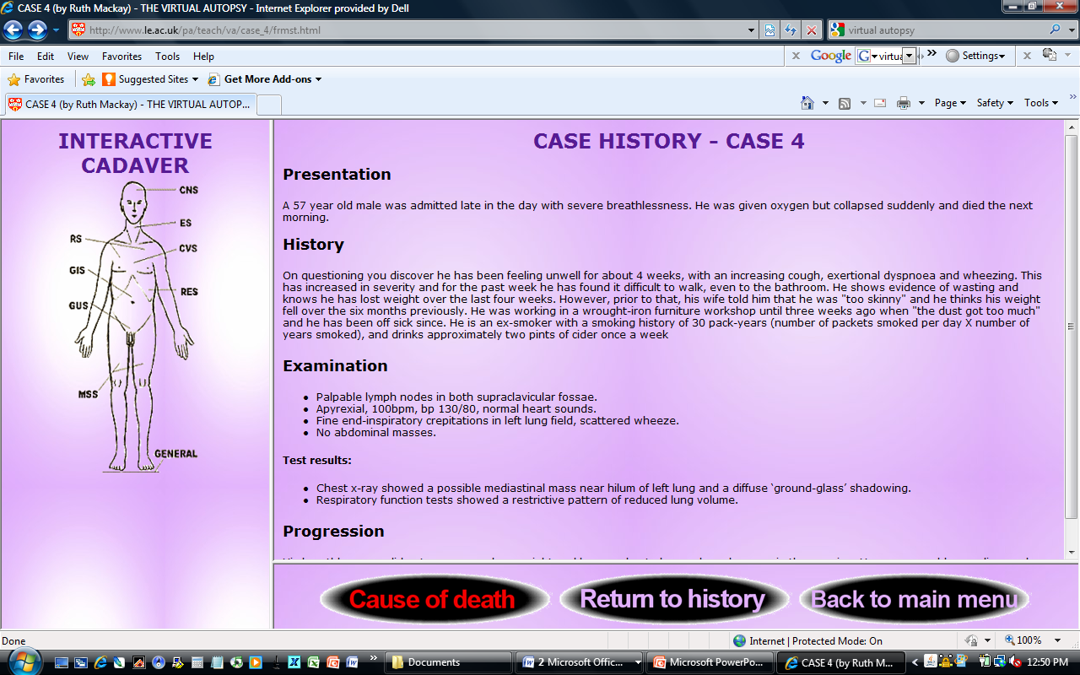
Choose a case, read the case history…

Slide 39
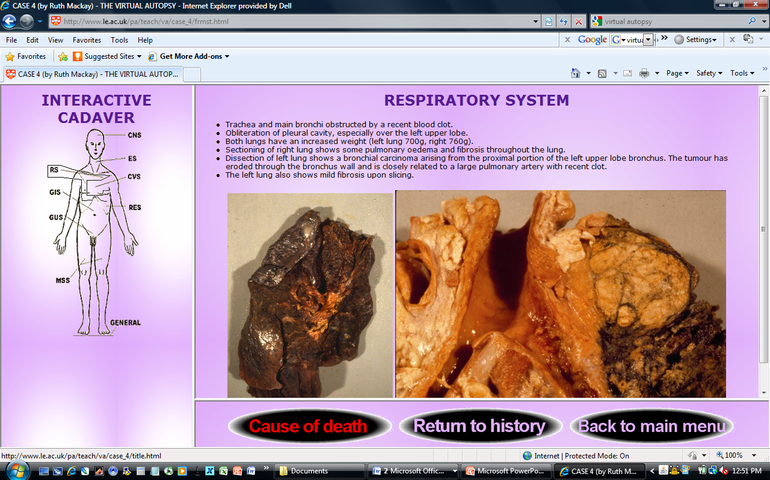
...examine autopsy findings…

Slide 40
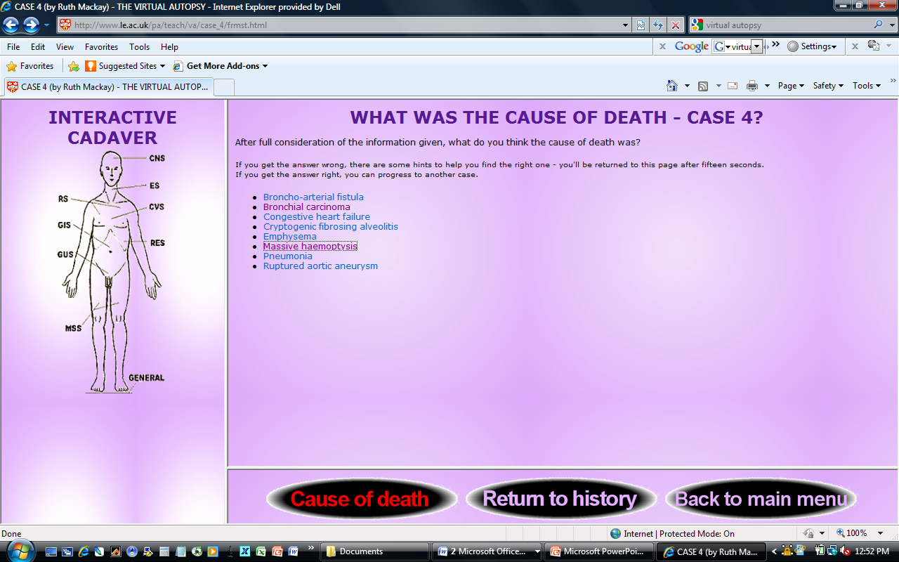
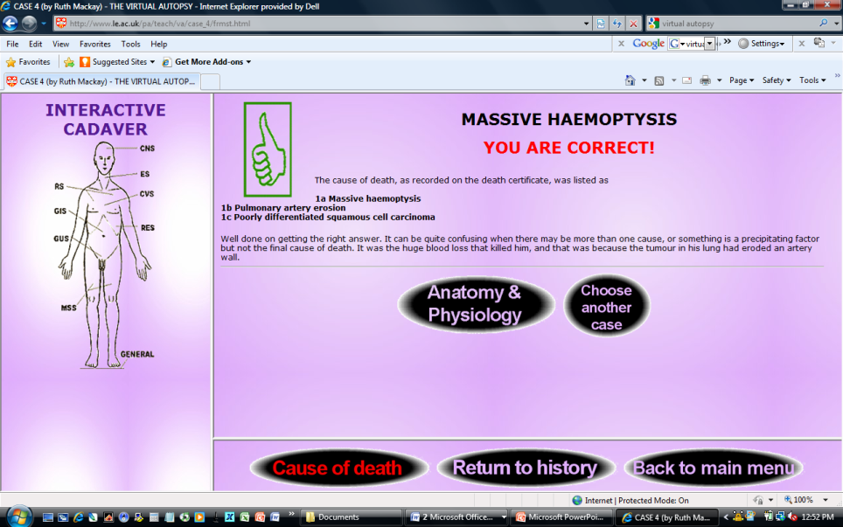
… and make a diagnosis

Slide 41
Medpix, a database of radiology teaching files and images
http://rad.usuhs.edu/medpix/

Slide 42
Visible Proofs
(history of forensic medicine website)
http://www.nlm.nih.gov/visibleproofs/index.html

Slide 43
The Pathology Guy (general topics on pathology as well as forensic issues)
http://www.pathguy.com/

Slide 44
Science resources for teachers:
NIH Curriculum Supplements
http://science.education.nih.gov/customers.nsf/highschool.htm

Slide 45
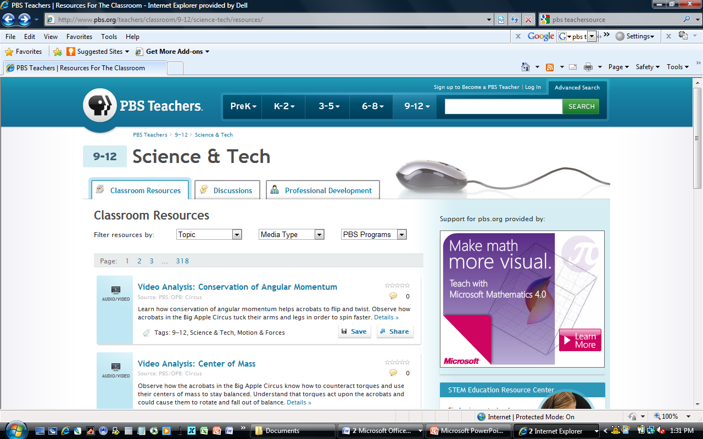
Science resources for teachers:
PBS Classroom Resources
http://www.pbs.org/teachers/classroom/9-12/science-tech/resources/

Slide 46
How do I know if a career in biology is right for me?
  http://www.onlinebiologydegree.com/
Information and advice on choosing a career in biology:
  Biology professions
  Career outlook
  Areas of study
  Personal anecdotes
  Personality quiz

Slide 47
Take a personality quiz…

Slide 48
…and find out the estimated salary growth for various biology professions

Slide 49
Science Buddies has more information about careers in biology, and a page devoted specifically to pathology
http://www.sciencebuddies.org/science-fairprojects/science_careers.shtml

Slide 50
ASIP’s Pathology: A Career in Medicine page also contains a helpful introduction to pathology, including subspecialties and case studies
http://www.asip.org/Career/index.htm

Slide 51
Thank you for your attention, and I hope you enjoy the rest of our program!
Special thanks to Kari Nejak-Bowen, Martha Furie, Stan Cohen, Kevin Gardner, and The American Physiological Society for the content and ideas for some slides

