Slide 1
Welcome and Introduction
Kari Nejak-Bowen
University of Pittsburgh School of Medicine
Department of Pathology
April 29, 2014

Slide 2

ASIP gratefully acknowledges support from the INTERSOCIETY COUNCIL FOR PATHOLOGY INFORMATION

Slide 3
Workshop Schedule:
10:00 AM Introduction
Kari Nejak-Bowen
10:20 AM Menacing Microbes: The Threat of Bioterrorism
Martha Furie, Stony Brook University
11:10 AM Break
11:20 AM Smoking-Related Lung Disease in 3D: Not Your Standard Lecture
Dani Zander, Pennsylvania State Hershey Medical Center
12:05 PM Break
12:15 PM Stem Cells: Story of Dr. Jekyll and Mr. Hyde
Paul Monga, University of Pittsburgh
1:15 PM Tour the Exhibits

Slide 4
What is Pathology?
Pathology is the study and diagnosis of disease processes.

Slide 5
Pathology incorporates a wide range of disciplines
Genetics
Micro-biology
Oncology
Molecular Biology
Bio-informatics
Bio-chemistry
Pathology
Anatomy
Compu tational Biology
Surgery
Cell
Biology
Histology
Epi-demiology

Slide 6
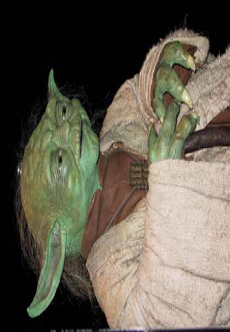
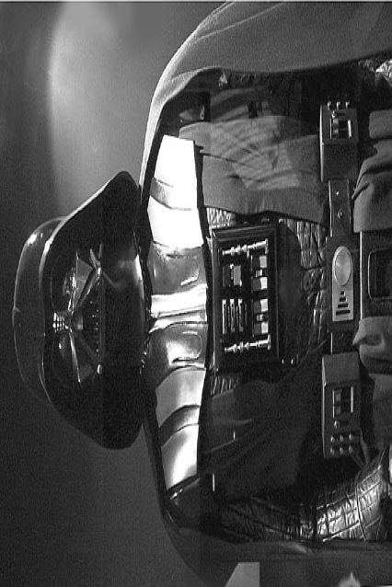
Biology
Pathology
Health
Order
Symbiosis
Homeostasis
Growth
Disease
Disorder
Parasitism
Imbalance
Cancer
Courtesy of Stanley Cohen and Martha Furie

Slide 7

Experimental Pathology…
A scientific field which investigates the type of injury and the body’s response to it by studying:
  Causes
  Processes
  Development
  Outcomes and consequences

Slide 8
Experimental Pathologists ask:
What causes disease?
How do we know who is at risk for disease?
How do we diagnose disease?
How do we understand the nature of the disease?
How do we use our understanding of the disease to develop treatments?

Slide 9
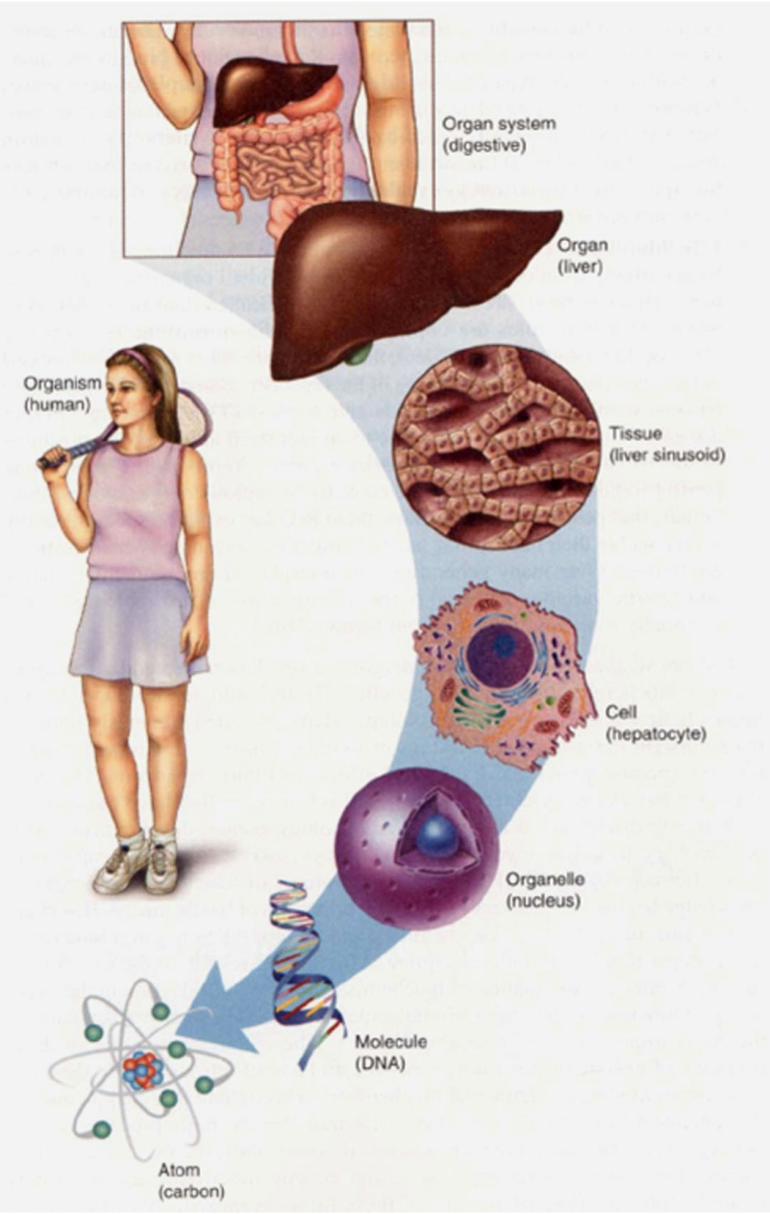
How do pathologists study disease?
Pathology can be studied at the organism, organ, cell, or molecular level
Cell and tissue responses to injury include:
  Injury/inflammation
  Repair/adaptation
  Neoplasia/cancer
redzuannorazlan.blogspot.com

Slide 10
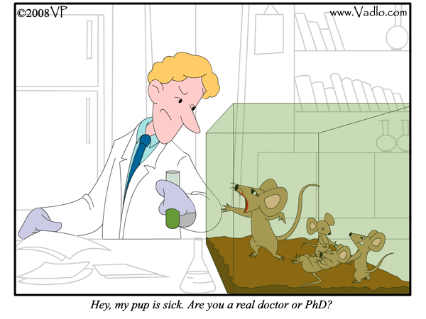
How do pathologists study disease?
Experimental pathologists often use cells grown in the laboratory to study the initiation and progression of disease
Animal models are also used in order to study the effect of a disease on the entire body

Slide 11
Misconceptions about animal research
Research on animals isn’t necessary
  We have to understand basic biology to learn how to treat/cure disease.
  Animals are used along with computer models, cell cultures and human studies.
Treatments developed in animals don’t work on people
  Knowledge attained through laboratory animal research has played a vital role in almost every major medical advance of the last century, including organ transplants, analgesics, antibiotics, anti-depressants, bypass surgery, heart catheterization, joint replacement, and more.

Slide 12
Misconceptions about animal research
Research is animal abuse
  Most research is not painful.
  If an animal is in pain, pain medication must be given.
  If an animal is suffering, it will be removed from the study or euthanized.
Researchers don’t care about animals
  Research is highly regulated, and researchers are committed to animal welfare.
  An Animal Care and Use Committee at each institution rigorously reviews all proposed studies.
  Veterinarians help design protocols.
  Animals get care from skilled technicians and veterinarians.

Slide 13
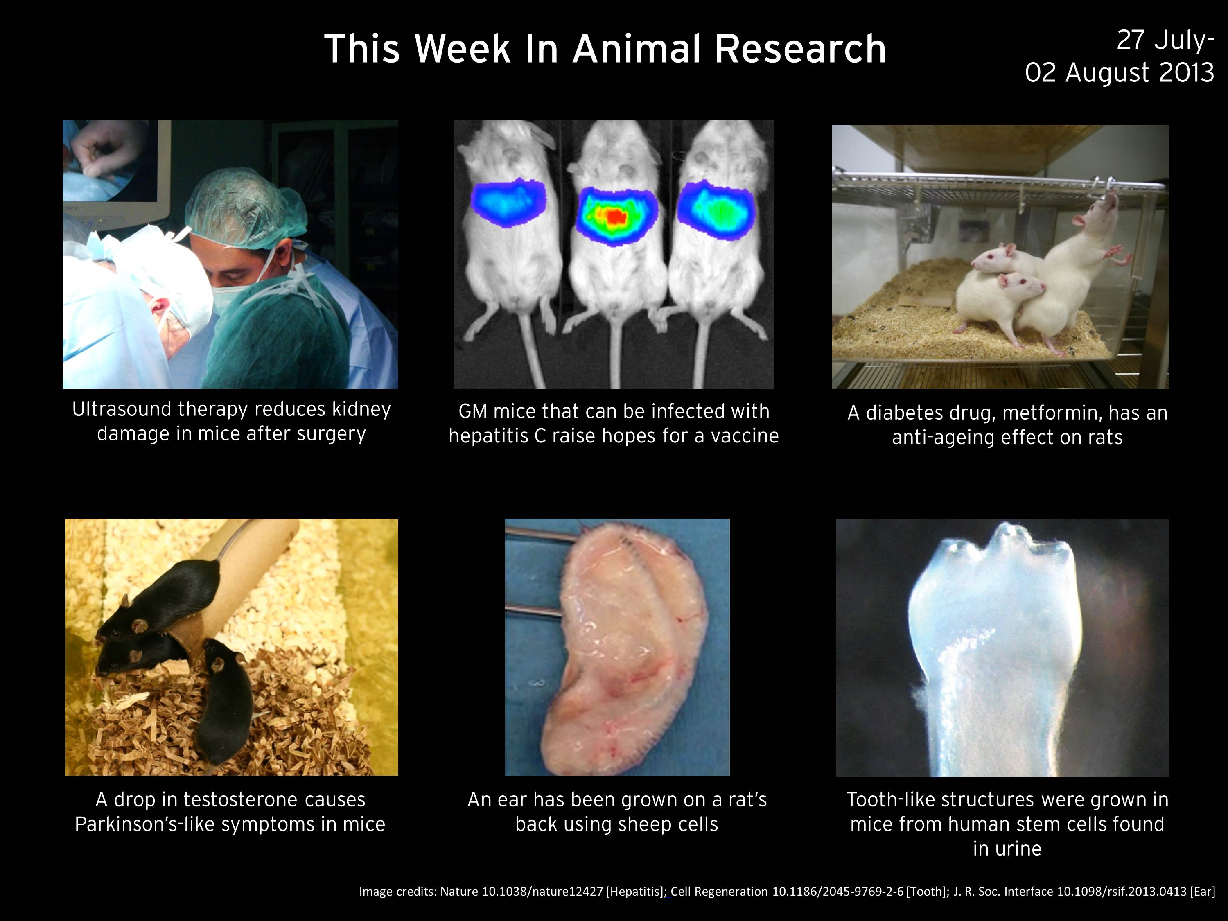
Animal research is essential for pathologists to understand disease and develop cures
http://www.understandinganimalresearch.org.uk/

Slide 14
Why teach pathology in high school?
Relevant and timely
  Our understanding of disease is becoming more advanced
  Health care is also becoming more complex
  Almost half of all Americans (90 million) are burdened with limited health literacy
  There is a wealth of misleading information on health and disease topics
Real-world application of science
  Many students have been affected by disease in their daily lives
Rewarding and interesting
  Knowing more about their own health and bodies can empower students

Slide 15
What pathology-related topics are high school students interested in learning more about?
Most Interested
Least Interested
AIDS
Cancer*
Genetic testing
Stem cells*
Biological warfare*
Allergies
Arthritis
Asthma
Tobacco
Obesity
Special thanks to Jaime Bhalla and Martha Furie

Slide 16
How to find information on pathology-related topics?
The internet is a great resource for both teachers and students
  Much of pathology is visual
  Pictures and examples will catch the attention of students
  A great self-learning tool, where students can progress at their own pace
  Opportunity for independent investigation
2 ways to find information about pathology:
  Internet search engines
  Health and patient education web sites

Slide 17
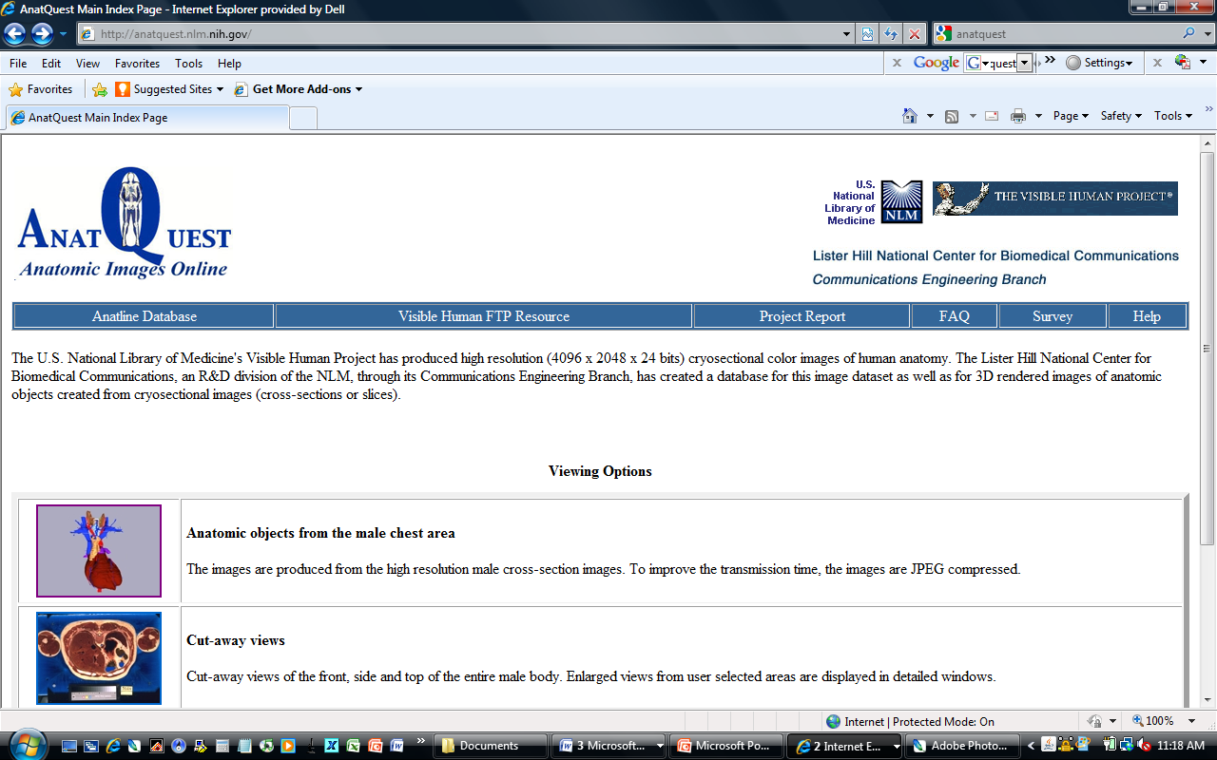
Anatquest, an NIH-sponsored site for anatomic images
http://anatquest.nlm.nih.gov/

Slide 18
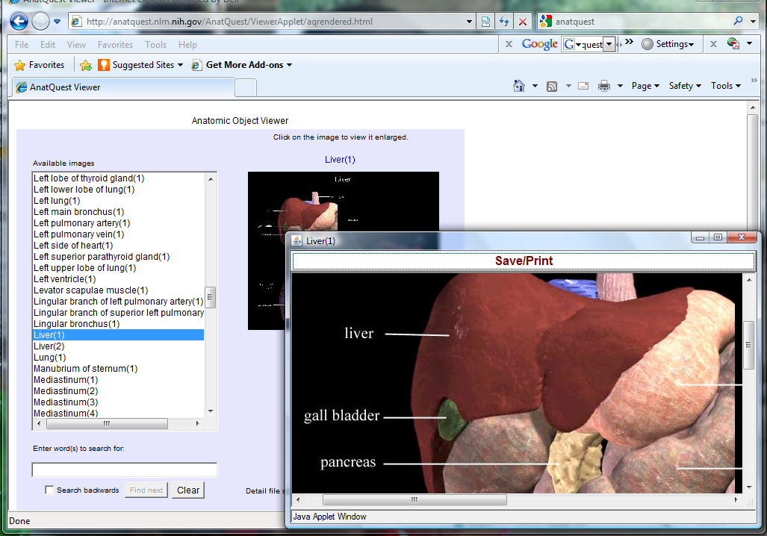
Anatquest anatomical viewer

Slide 19
Webpath, a website containing images and descriptions of diseases & pathologic conditions
http://library.med.utah.edu/WebPath/webpath.html

Slide 20
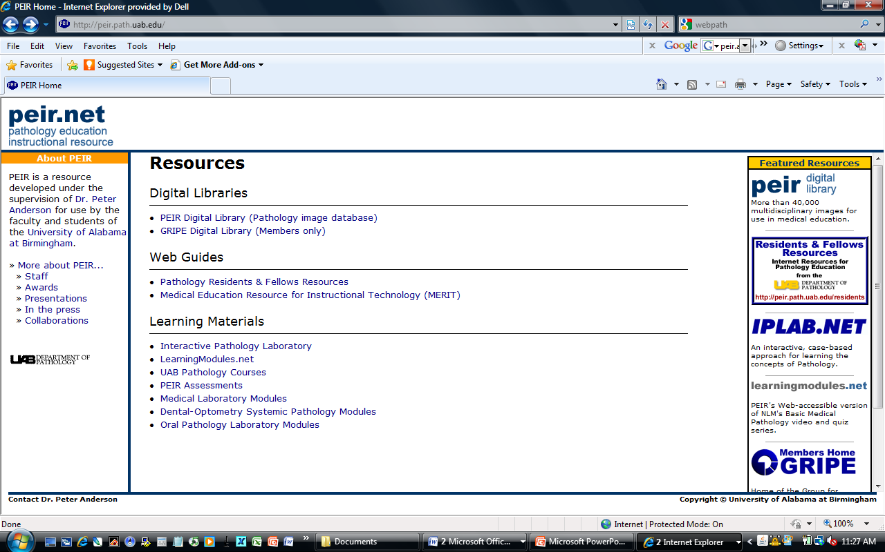
PEIR, another pathology-related educational resource
http://peir.path.uab.edu/

Slide 21
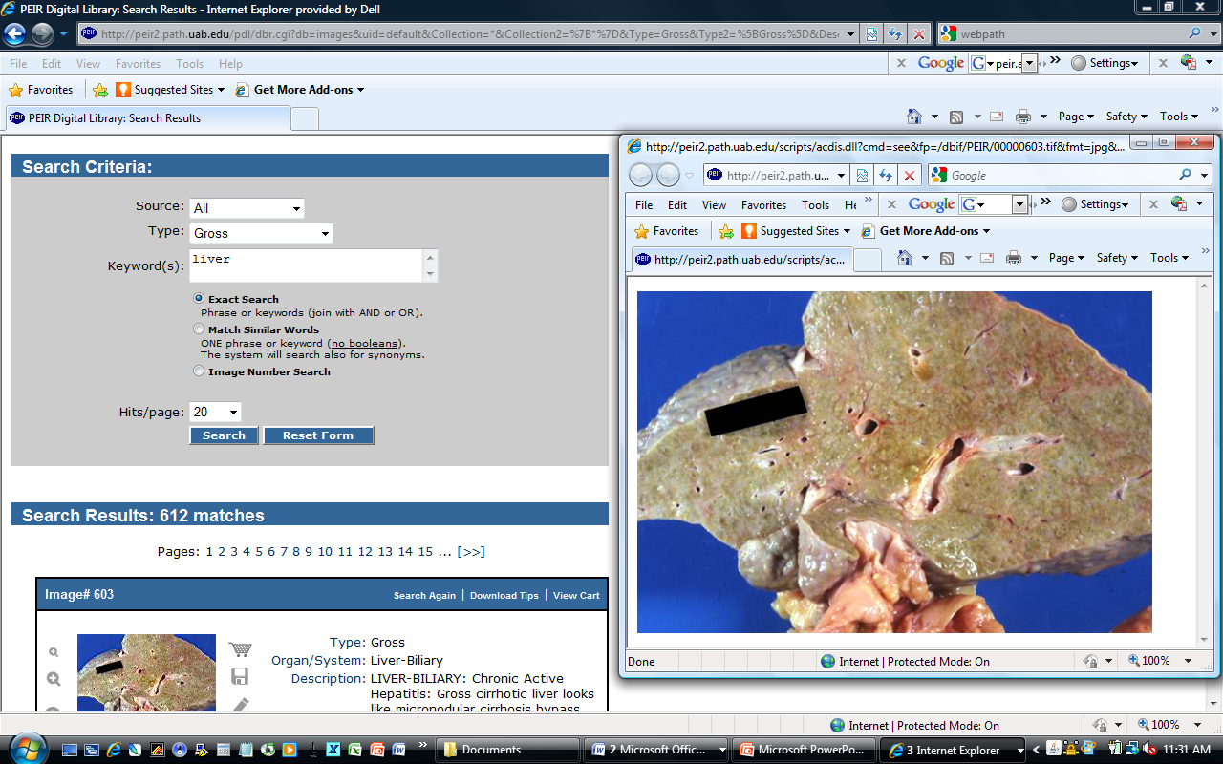
Searching the PEIR database

Slide 22
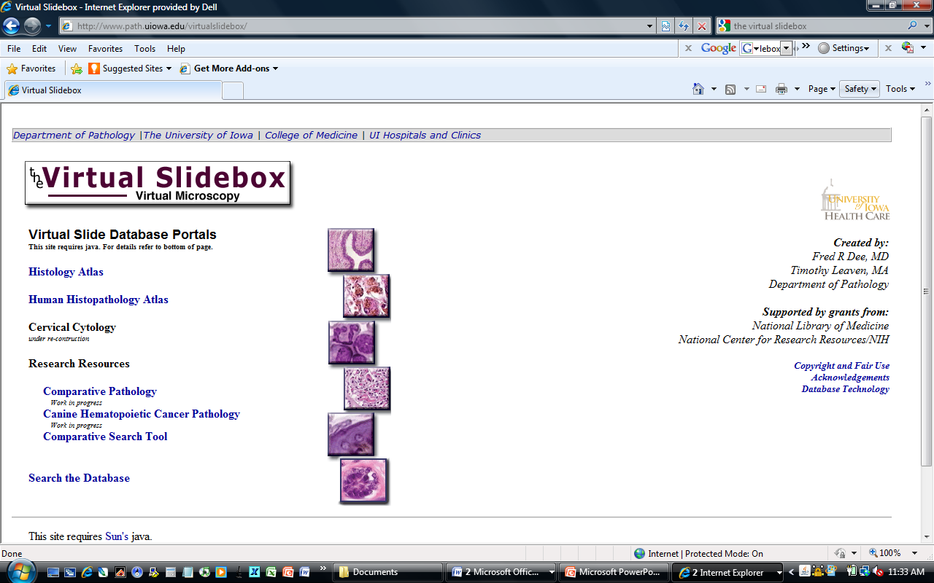
The Virtual Slidebox shows images of tissues microscopically
http://www.path.uiowa.edu/virtualslidebox/

Slide 23
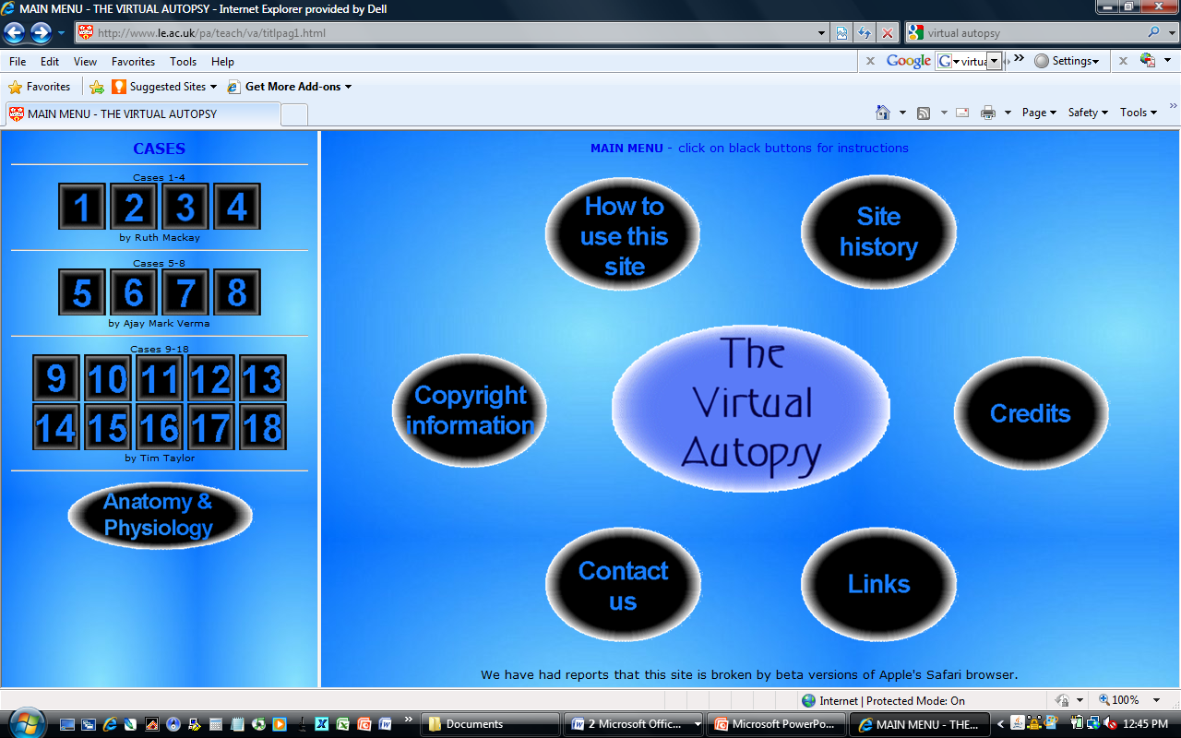
Virtual Autopsy is an interactive experience that allows students to diagnose cases
http://www.le.ac.uk/pa/teach/va/welcome.html

Slide 24
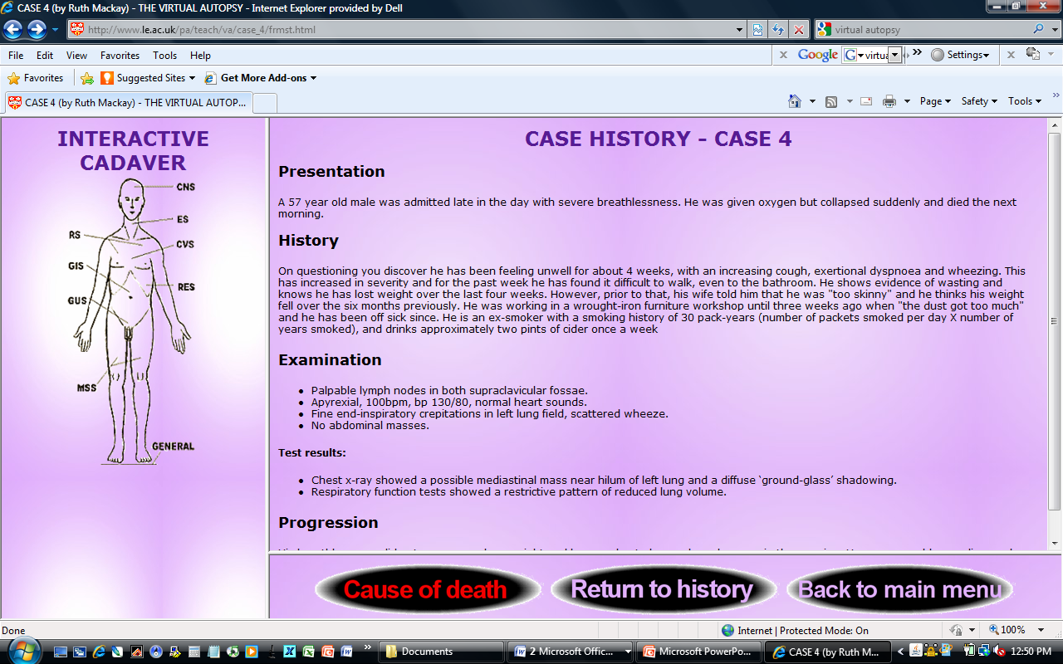
Choose a case, read the case history…

Slide 25
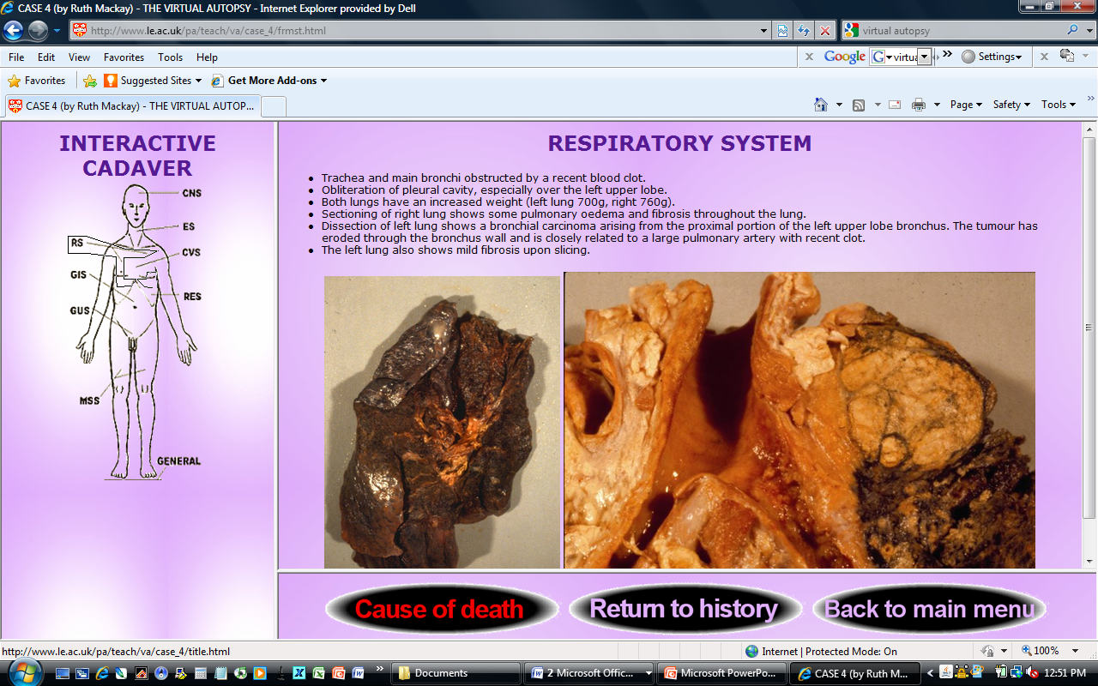
...examine autopsy findings…

Slide 26
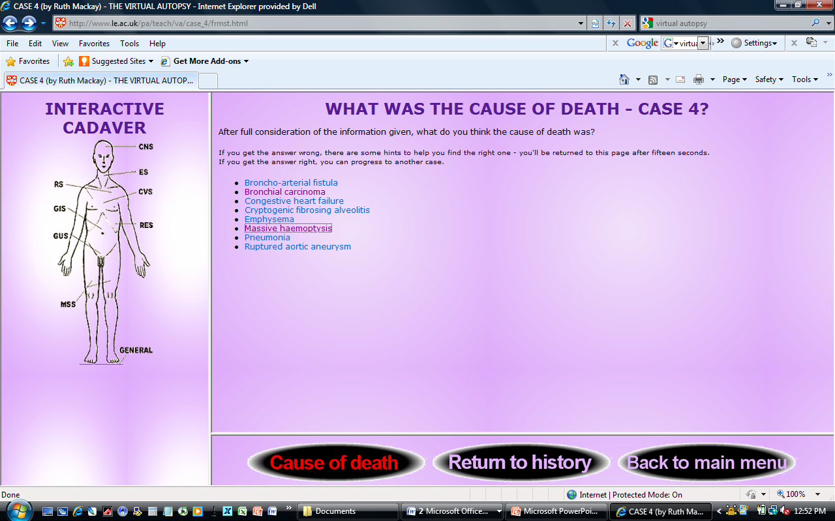
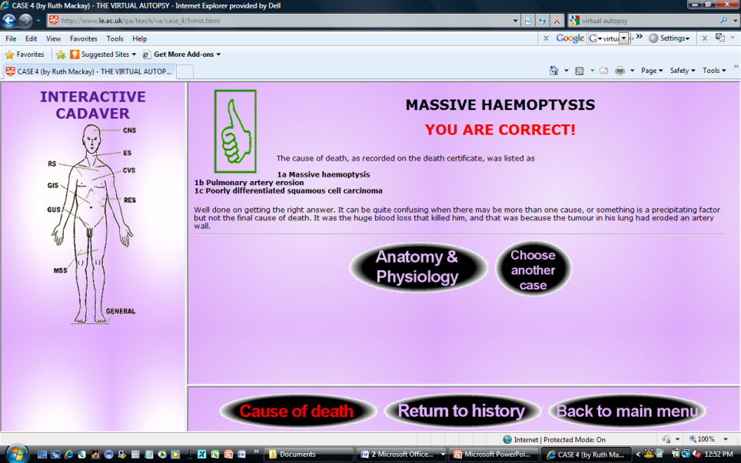
… and make a diagnosis

Slide 27
Medpix, a database of radiology teaching files and images
http://rad.usuhs.edu/medpix/

Slide 28
Visible Proofs (history of forensic medicine website)
http://www.nlm.nih.gov/visibleproofs/index.html

Slide 29
The Pathology Guy (general topics on pathology as well as forensic issues)
http://www.pathguy.com/

Slide 30
Science resources for teachers: NIH Curriculum Supplements
http://science.education.nih.gov/customers.nsf/highschool.htm

Slide 31
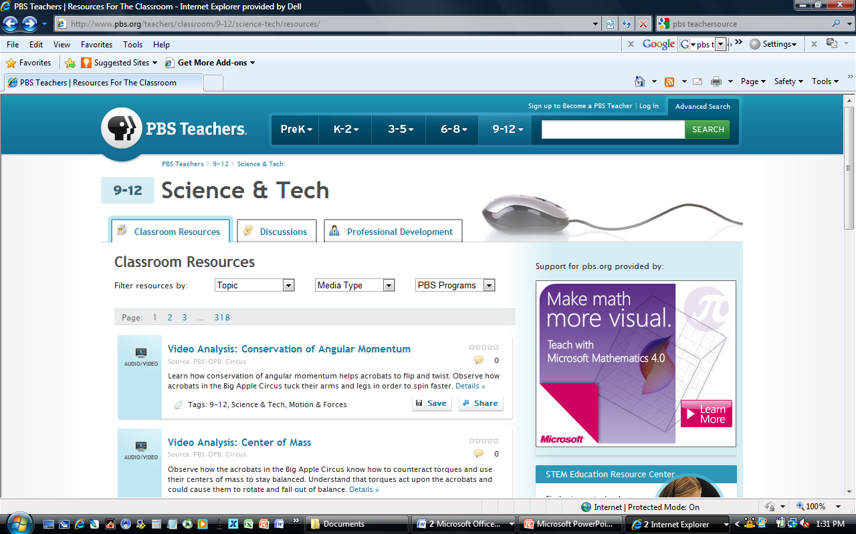
Science resources for teachers: PBS Classroom Resources
http://www.pbs.org/teachers/classroom/9-12/science-tech/resources/

Slide 32
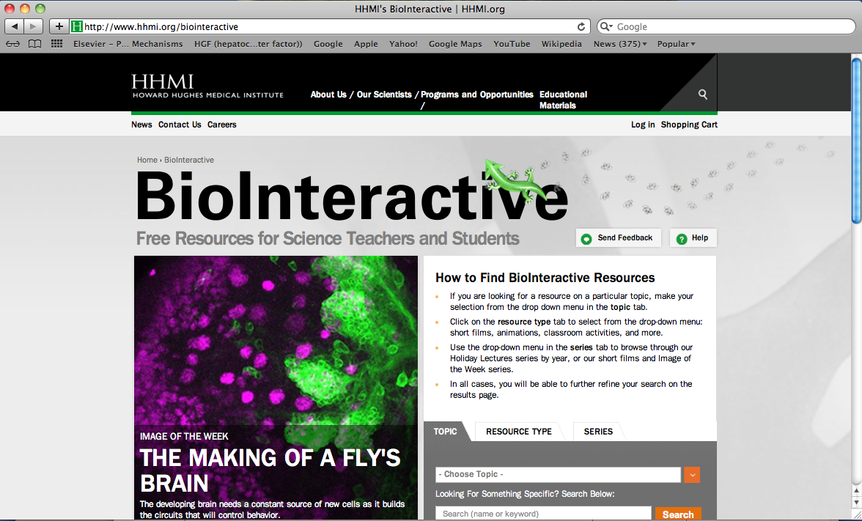
Science resources for teachers: Howard Hughes Medical Institute
http://www.hhmi.org/biointeractive

Slide 33
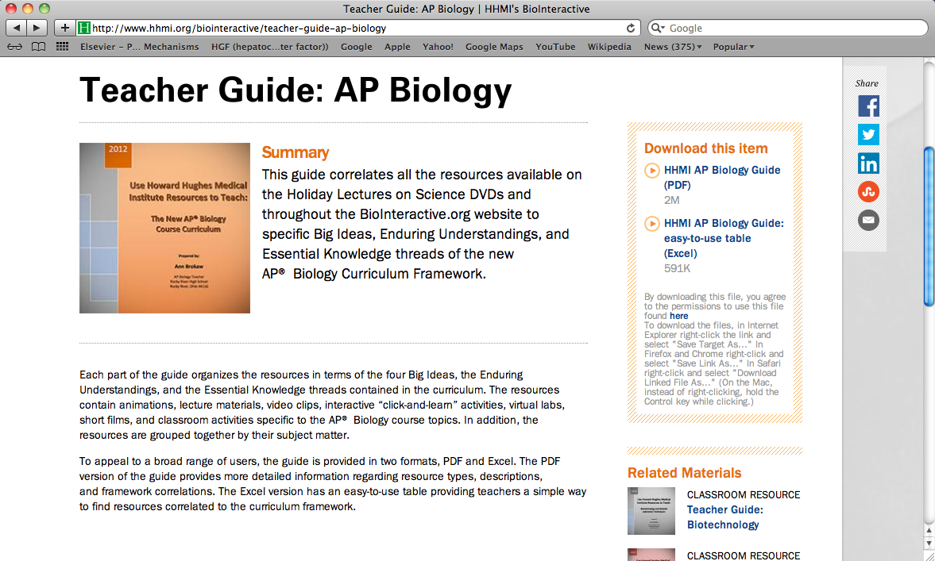
HHMI’s Biointeractive resources include Teacher Guides for many topics in biology

Slide 34
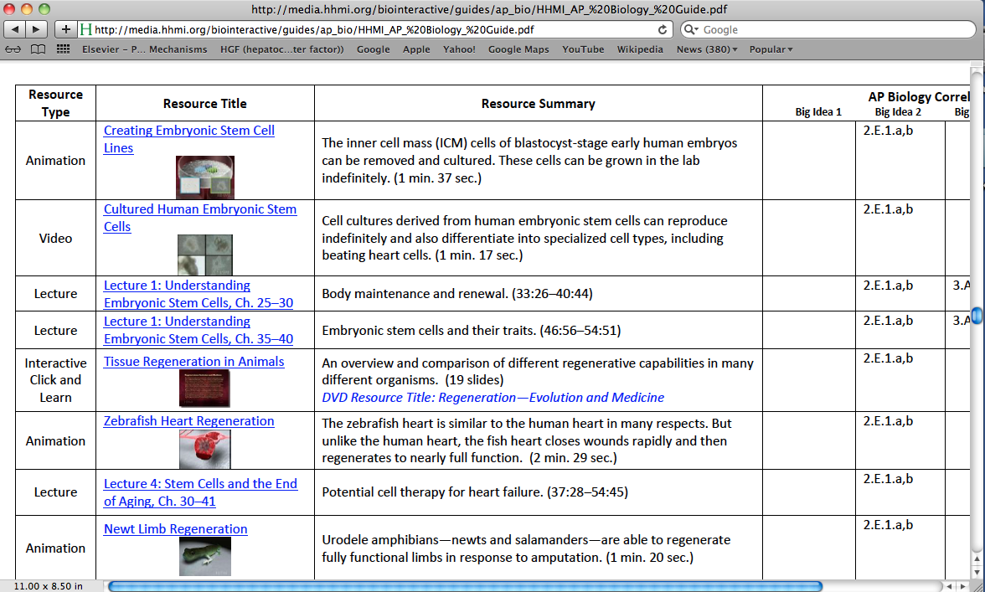
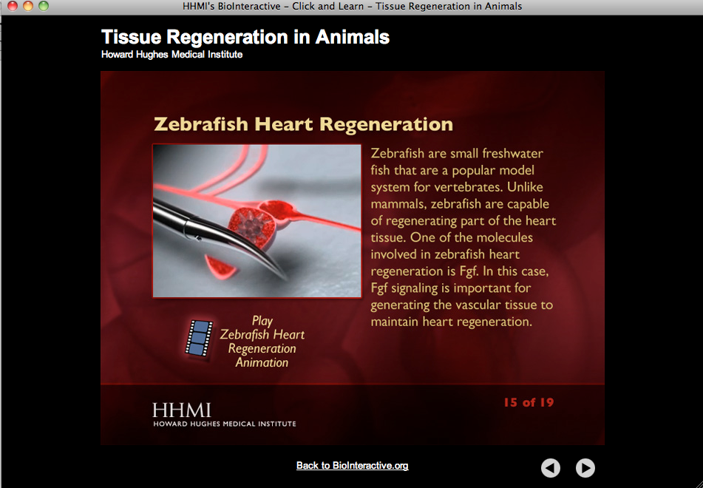
An example of content in the HHMI Teacher Guides

Slide 35
How do I know if a career in biology is right for me?
http://www.onlinebiologydegree.com/ has information and advice on choosing a career in biology
  Biology professions
  Career outlook
  Areas of study
  Personal anecdotes
  Personality quiz

Slide 36
Take a personality quiz…

Slide 37
…and find out the estimated salary growth for various biology professions

Slide 38
Science Buddies has more information about careers in biology, and a page devoted specifically to pathology
http://www.sciencebuddies.org/science-fair-projects/science_careers.shtml

Slide 39
ASIP’s Pathology: A Career in Medicine page also contains a helpful introduction to pathology, including subspecialties and case studies
http://www.asip.org/Career/index.htm

Slide 40
Thank you for your attention, and I hope you enjoy the rest of our program!
Special thanks to Martha Furie, Stan Cohen, and Kevin Gardner for the content and ideas for some slides

