Slide 1


STEM CELLS: STORY OF DR. JEKYLL
AND Mr. HYdE
April 2014
Sleuthing for High School Teachers and Students
EB2014: ASIP
SATDARSHAN (Paul) S. MONGA, M.D.
Vice Chair and Endowed Chair
Division of Experimental Pathology
Professor of Pathology and Medicine
University of Pittsburgh, SOM

Slide 2
What are stem cells ?
Stem Cells: Cells that have the ability to divide for indefinite periods in culture and to give rise to specialized cells.
Stem Cells: Cells that have the ability to perpetuate themselves through self-renewal and to generate mature cells of a particular tissue through differentiation.

Slide 3
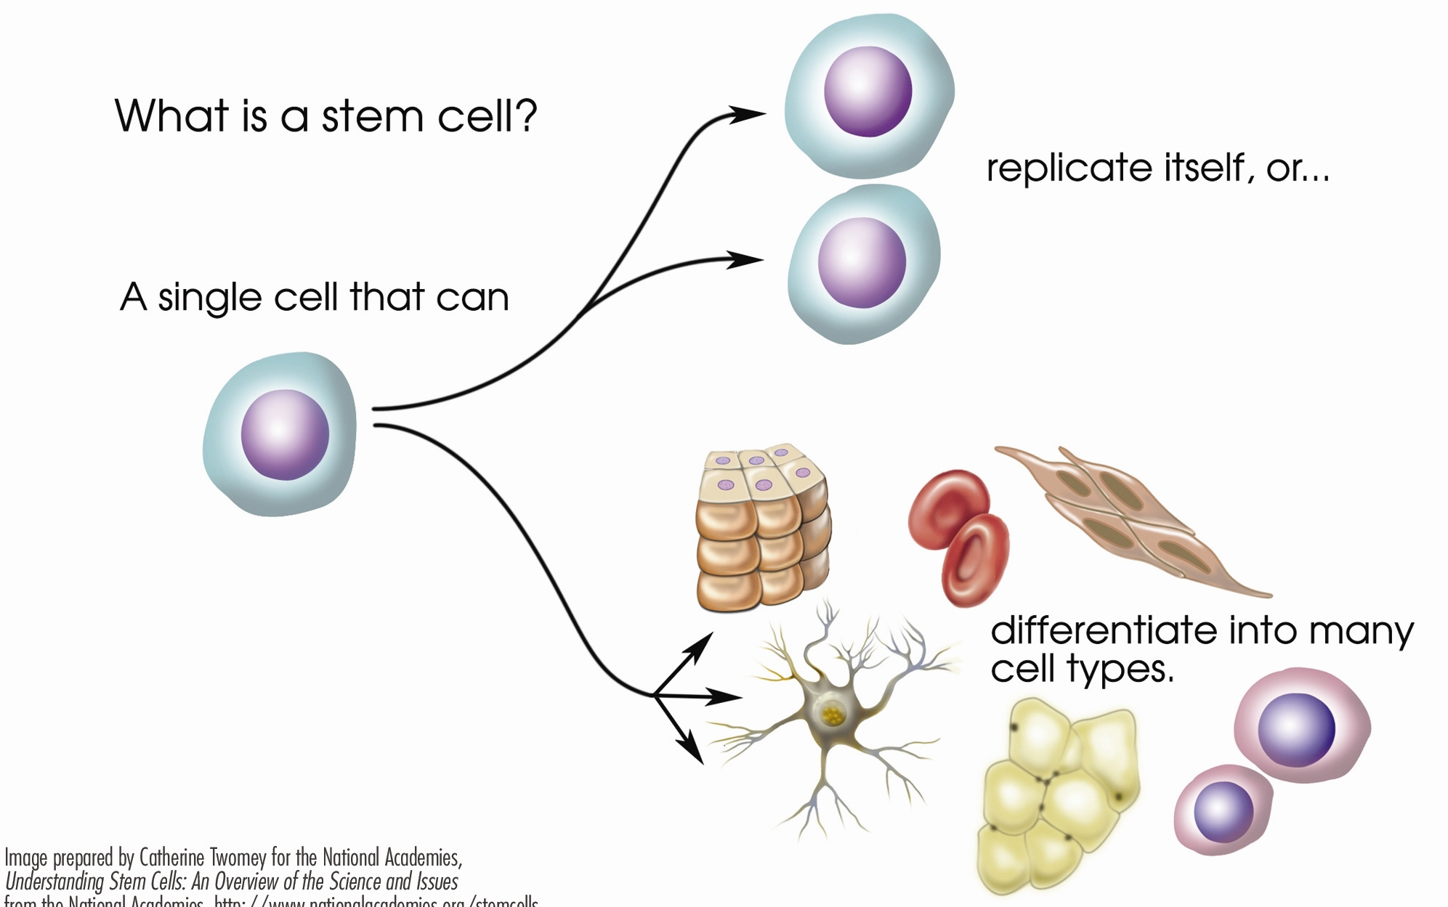
STEM CELL
replicate itself &

Slide 4
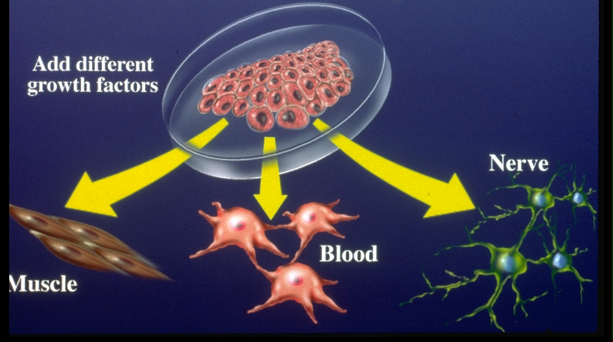
STEM CELL PROMISE

Slide 5
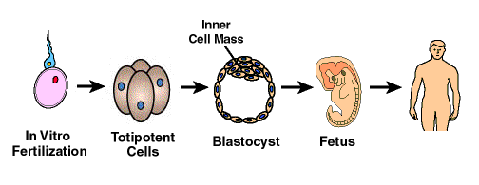
Development: A MODEL TO STUDY STEM CELLS

Slide 6
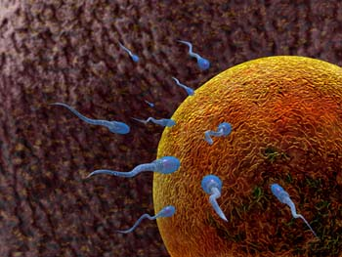
FERTILIZATION: FIRST STEP IN DEVELOPMENT
Fusion of gametes-egg and sperm to form the zygote and can take place in vivo/in vitro

Slide 7
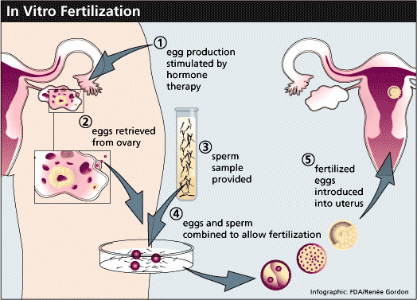
IN VITRO FERTILIZATION

Slide 8
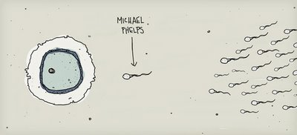
IN VIVO FERTILIZATION

Slide 9
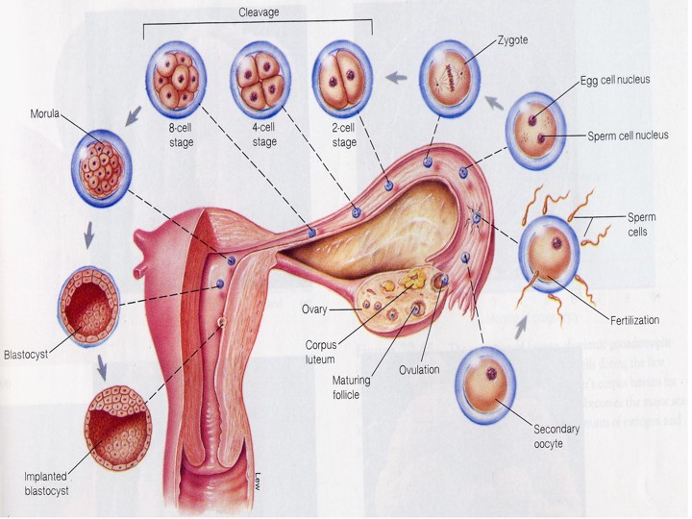
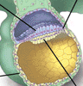
FERTILIZATION & IMPLANTATION
ZYGOTE
MORULA
FERTILIZATION
BLASTOCYST
Epiblast
Hypoblast
IMPLANTED
BLASTOCYST

Slide 10
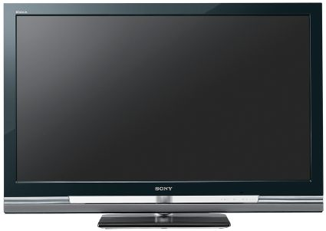

STEM CELLS AT WORK IN DEVELOPMENT

Slide 11
TYPE OF STEM CELLS
Totipotent stem cells
Pluripotent stem cells
Multipotent stem cells

Slide 12
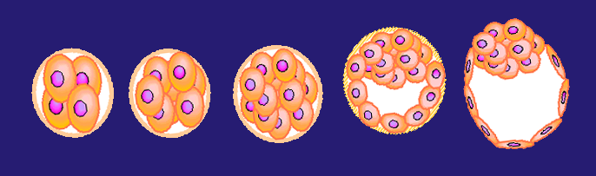
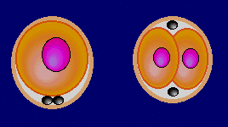
TOTIPOTENT STEM CELLS
“total potential”
  one cell giving rise to all cells
  one cell placed in uterus can give rise to entire baby
  One reason for twins is separation of these cells early during development
  Only for a short period of time

Slide 13
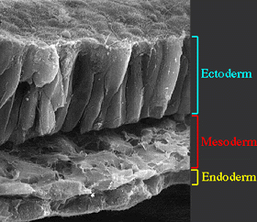
PLURIPOTENT STEM CELLS
Epiblast
Hypoblast
  One cell giving rise to 3 germ layers (endoderm, ectoderm, mesoderm) from which all body parts are formed
  These cells can’t give rise to placenta or germ cells & thus can’t form a baby if put in uterus

Slide 14
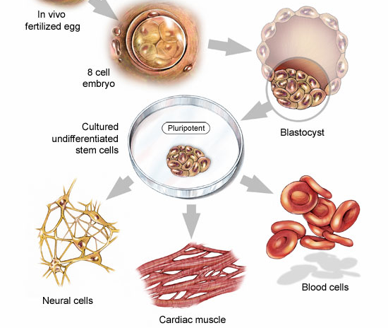
ICM IN BLASTOCYST IS THE BEST SOURCE OF EMBRYONIC STEM CELL WHICH IS THE BEST EXAMPLE OF A PLURIPOTENT SC
Inner Cell
Mass

Slide 15
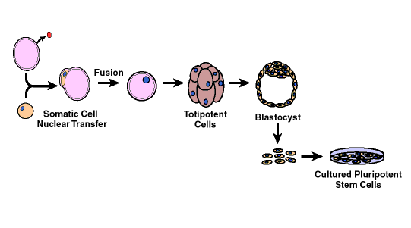
Because ES cells created from unused IVF eggs there were ethical concerns!
SOMATIC CELL NUCLEAR TRANSFER PROTOCOL WAS INVENTED
Ovum

Slide 16
CARTOON OF SCNT

Slide 17
JURASSIC PARK
COULD JURASSIC PARK BE CREATED?

Slide 18
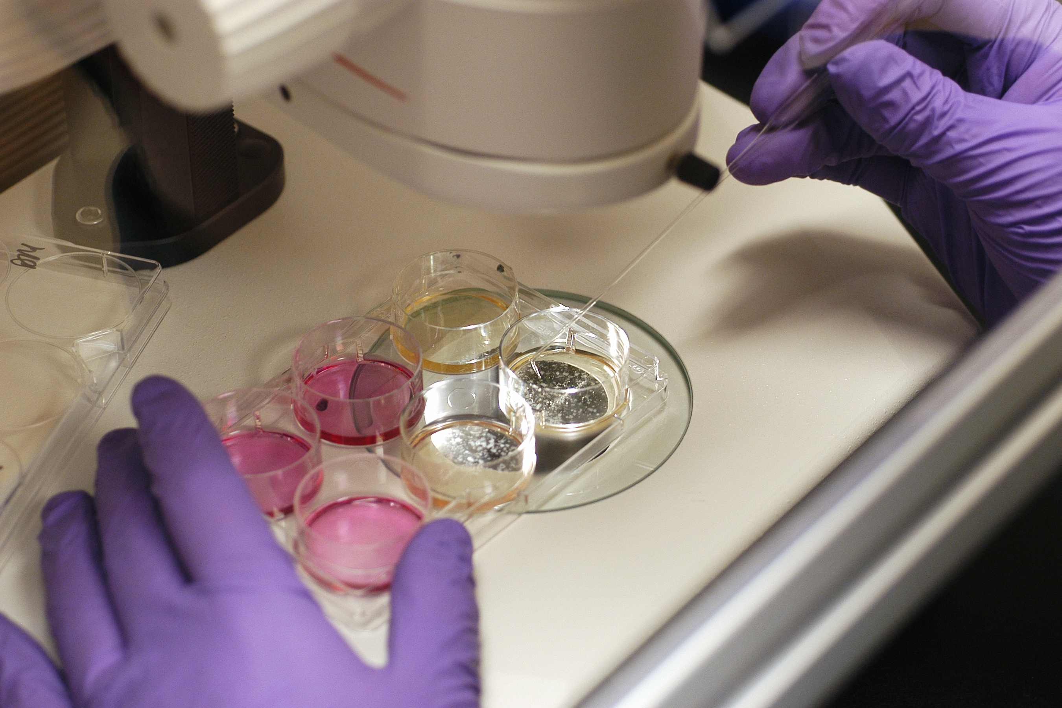
CULTURE OF STEM CELLS

Slide 19
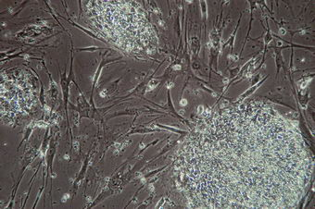
Human ES CELL CULTURE
Cultured on mouse embryonic fibroblasts so they stay SC

Slide 20
STEM CELL PROMISE

Slide 21
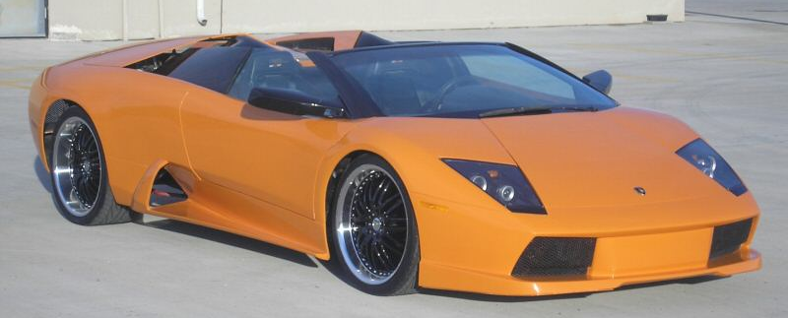
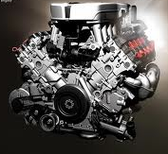
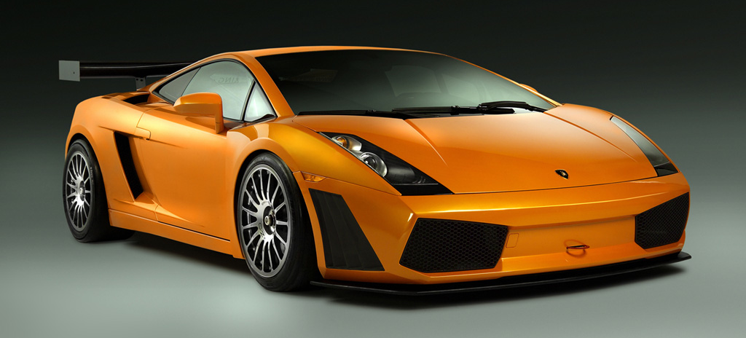
WHAT MAKES STEM CELLS, STEM CELLS? WHAT IS THE ENGINE UNDER THE HOOD?

Slide 22
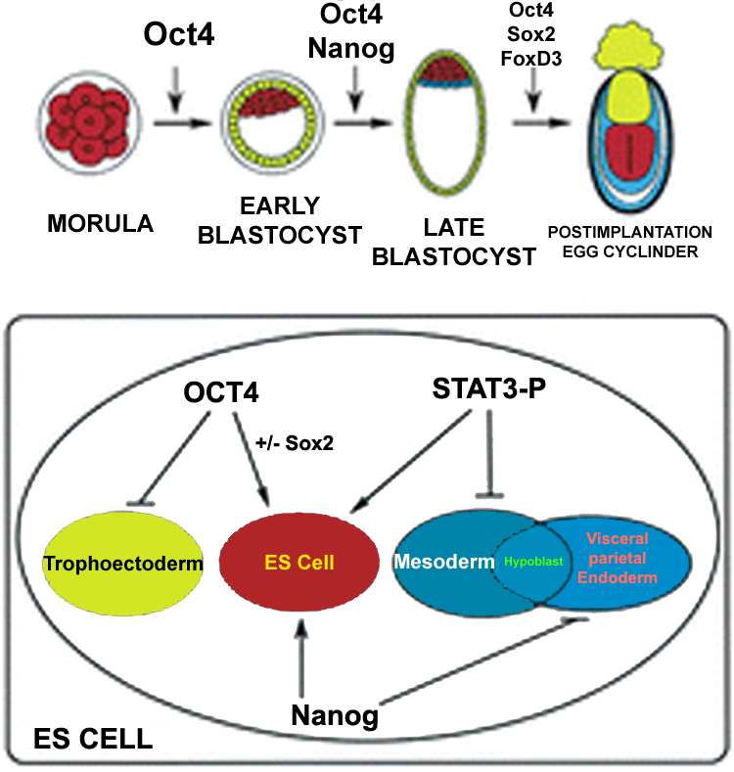
GENES/PROTEINS THAT CONTROL SELF-RENEWAL

Slide 23
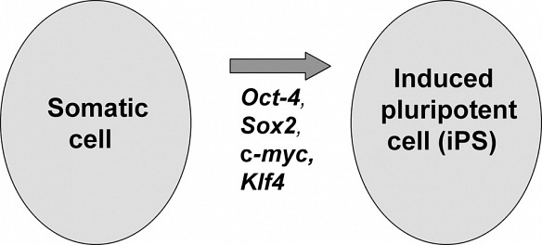
What if some of these genes are added to adult cells?
Oct3/4 (Oct4 or Pou5f1), Sox2, c-myc, Klf4
Oct3/4, Sox2, Nanog and Lin38

Slide 24
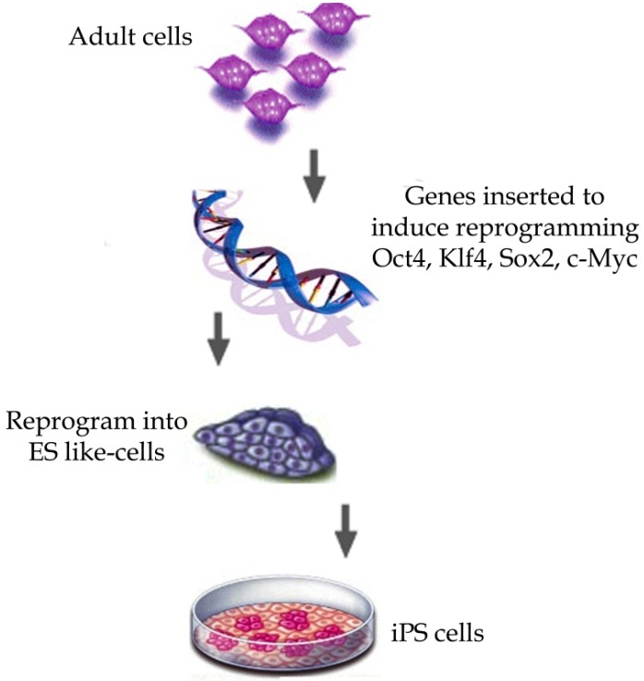
iPS CELLS

Slide 25
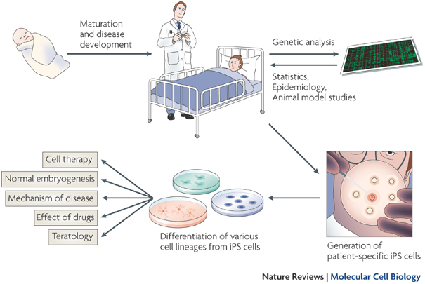
PROMISE OF iPS CELLS

Slide 26
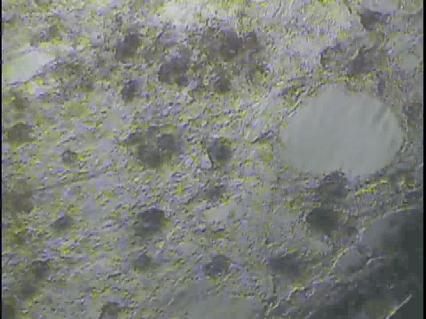
Use of iPS cells to make heart muscle cells

Slide 27
MULTIPOTENT STEM CELLS
(Tissue specific stem cells)
  Some organs in our body have high turn over rate and they need SC to replace the tissue and maintain its functions
  Some examples:
    Gut
    Skin
    Blood

Slide 28
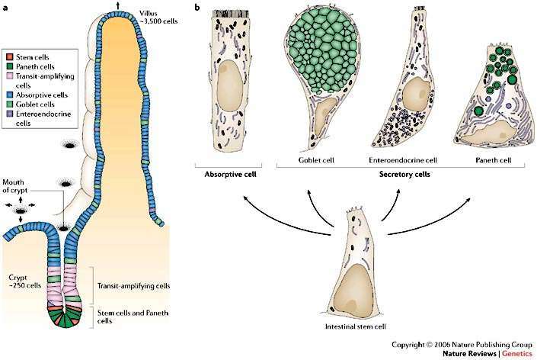
EVERY 6-8 DAYS WE REPLACE OUR GUT CELLS: A STEM CELL IS REQUIRED
VILLI
CRYPTS
STEM CELLS
SC play a key role in adult gut homeostasis

Slide 29
Use of adult stem cells for treatment
Bone marrow derived stem cells
Muscle derived stem cells
Skin derived stem cells
Fat derived stem cells

Slide 30
How can adult stem cells be isolated and used?
One Example:
Clinical

Slide 31
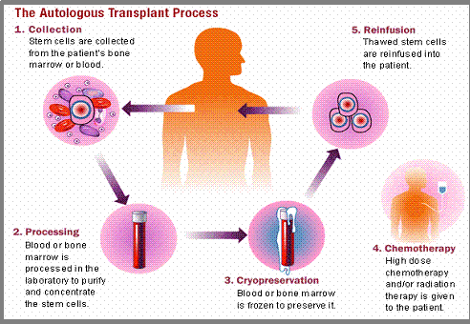
STEM CELL TRANSPLANTATION IN CANCER

Slide 32
HSC MOBILIZATION FROM BM

Slide 33
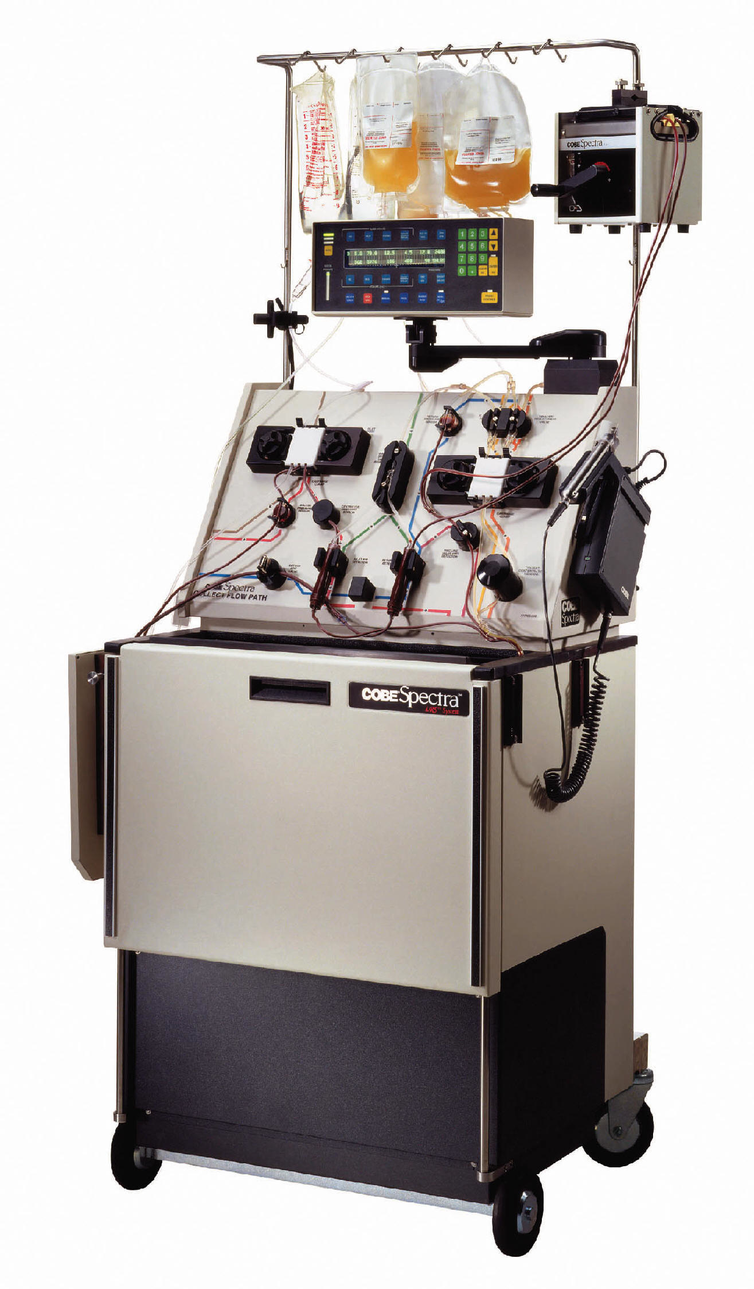
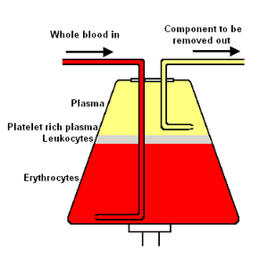
APHERESIS

Slide 34
STEM CELL TRANSPLANTATION IN CANCER

Slide 35
Uses of Stem cell
Used to maintain tissues in our body such as gut, skin and blood on routine basis
Stem cells can be used engineer tissues for putting back in patients (skin grafts)
Stem cells can be used inside devices that are used to treat organ failure (liver)
Stem cells can be injected back into body to form new tissue after killing cancer cells by radiation

Slide 36
GOOD AND BAD!

Slide 37
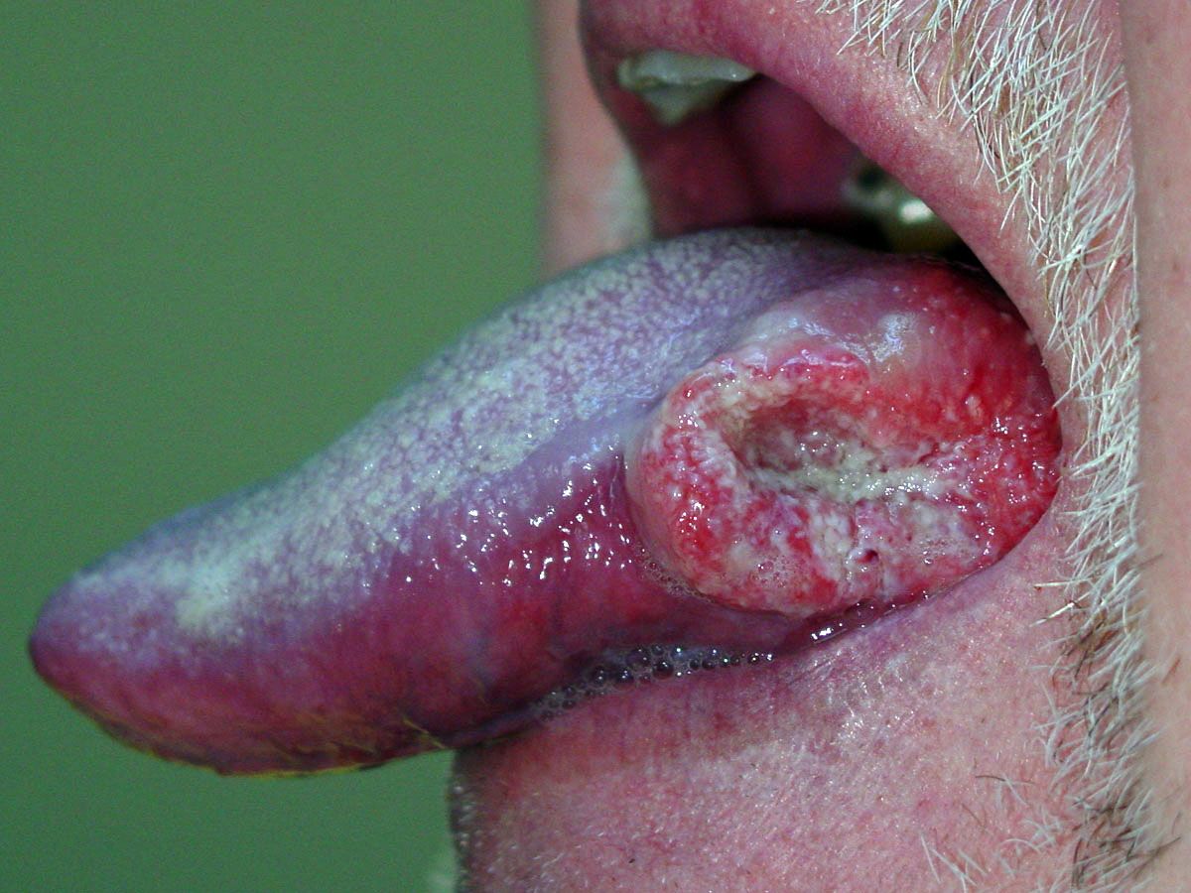
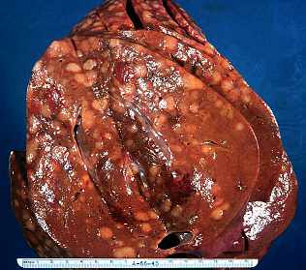
CANCER
Cancer is a disease where cells begin to grow and divide and can move out to other tissues

Slide 38
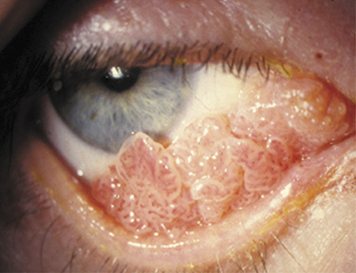
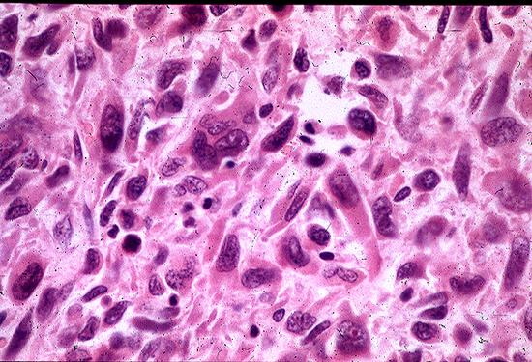
TUMOR CONSISTS OF DIFFERENT TYPES OF CELLS (HETEROGENEITY)

Slide 39
CANCER STEM CELLS
Not all tumor cells within a tumor have the same capacity to divide
FOR EXAMPLE:
  around 1 in 10,000 cancer cells can form a tumor in a colony forming assays
This suggests presence of limited number of cells with
Cancer initiating/propagating properties i.e. CSC

Slide 40
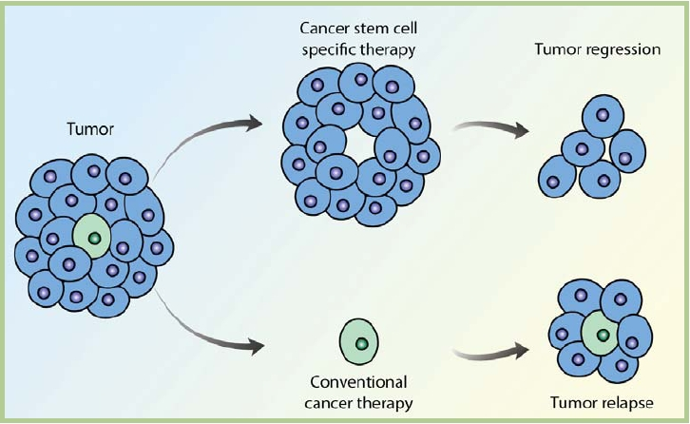
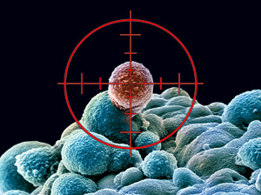
WHY TARGETING CSC MAY IMPROVE CANCER TREATMENT

Slide 41
STEM CELLS: A CASE OF JEKYLL AND HYDE
Homeostasis
Regeneration
Repair
Tissue
Engineering
Cell therapy
Devices
Cancer
Other stem cell diseases

Slide 42
JURASSIC PARK: COULD IT EVER BE A REALITY?
Contamination of mosquito DNA with dinosaur DNA
An intact nucleus is necessary (which will not be possible because nuclei fracture over years)
An intact functioning cell from dinosaur is necessary to put genes/nucleus back in to make a functional dinosaur stem cell
Going forward, freezing ovum, sperms and other cells in different zoo’s may be important to prevent extinction, although therapeutic cloning is extremely inefficient as it stands now!

