Slide 1
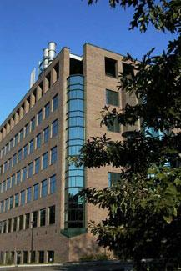

Menacing Microbes:
The Threat of Bioterrorism
Martha B. Furie
Center for Infectious Diseases
Stony Brook University
Martha.Furie@stonybrook.edu

Slide 2
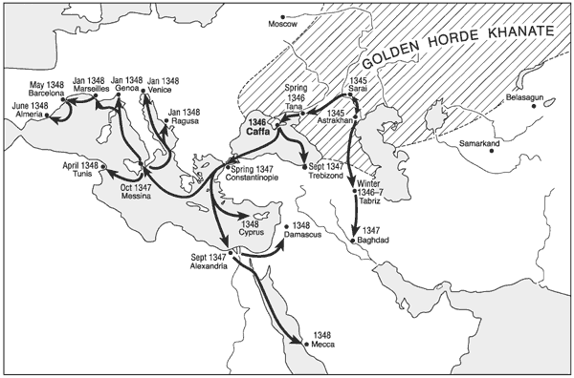
Biowarfare: an Ancient Enterprise
The siege of Caffa (1346)
  Bodies of plague victims were catapulted into the city
Wheelis M, Emerging Infectious Diseases 8:971, 2002

Slide 3
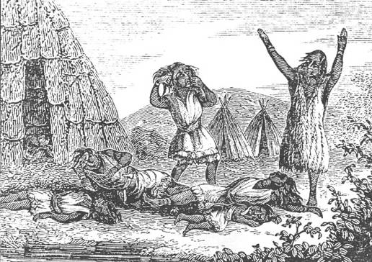
Biowarfare: an Ancient Enterprise
French and Indian Wars (1754-1767)
  British forces gave smallpox-laden blankets to the Native Americans
http://www.bethelhistorical.org/Molly_Ockett_and_Her_World.html

Slide 4
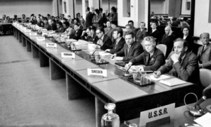
Bioweapons in the 20th Century
Geneva Protocol (1925)
  Prohibited use of chemical and biological weapons in warfare
  Did not address production of such weapons
  Had no provisions for enforcement
  Active programs to develop bioweapons in the US, USSR, UK, France, and Japan
Biological Weapons Convention (1975)
  Forbids the development, production, and stockpiling of biological and toxin weapons
  Ratified by 158 governments
http://www.un.org/disarmament/content/slideshow/bwc/

Slide 5
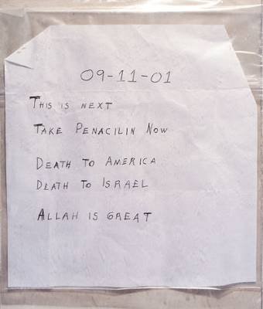

The 21st Century Concern: Bioterrorism
The US anthrax attacks
  Seven letters containing anthrax spores were mailed in September and October 2001
  22 people were infected; five died
  The FBI concluded a former Army researcher acted alone
http://www.fbi.gov/pressrel/pressrel01/102301.htm

Slide 6
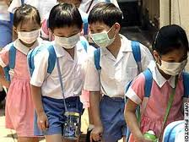
Centers for Disease Control and Prevention’s Select Agent List
Tier 1 (the really bad guys)
  Greatest risk for misuse
  Highest potential for:
    Mass casualties
    Adverse effects to the economy
    Adverse effects on critical infrastructure
    Public panic
http://adorngeoist.wikispaces.com/SARs

Slide 7
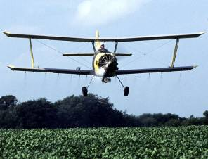
Some Tier 1 Select Agents
Bacillus anthracis
  Anthrax
Yersinia pestis
  Plague
Francisella tularensis
  Tularemia
Clostridium botulinum
  Botulism
Variola major
  Smallpox
Ebola and Marburg viruses
  Viral hemorrhagic fevers
50 kg of anthrax spores dispersed by a crop duster over a city of 500,000 could kill about 95,000 people.
Similar dispersal of F. tularensis could kill as many as 30,000 people.
Health Aspects of Chemical and Biological Weapons. World Health Organization, 1970.
http://commons.wikimedia.org/wiki/Image:Crop_Duster.jpg

Slide 8
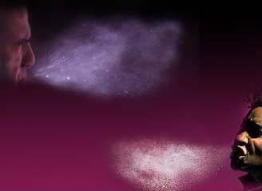
B. anthracis, Y. pestis, and F. tularensis
All can enter the body through multiple routes
Infection through the skin causes the mildest disease
Infection through inhalation causes the worst disease
Dispersal of aerosols is of greatest concern
http://www.health.qld.gov.au/EndoscopeReprocessing/images/page_images/114_sneeze.jpg

Slide 9
B. anthracis, Y. pestis, and F. tularensis
All can avoid getting killed by macrophages.
  The normal role of the macrophage is to ingest and destroy invading microorganisms by the process of phagocytosis.
Lysosome
Phagocytic vacuole
(Phagosome)
Phagolysosome

Slide 10
Phagocytosis
A movie will be presented showing phagocytosis by a type of white blood cell called a neutrophil.
J.G. Hirsch, J Exp Med 116:827, 1962

Slide 11
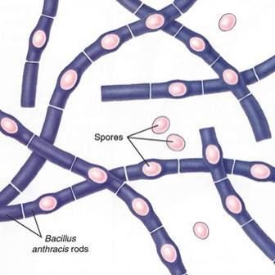
Bacillus anthracis: Anthrax
In the infected host, anthrax exists as a vegetative form. In the environment, it forms dormant spores that are extremely hardy.
Weaponized anthrax is the spore form made into 5-micron particles, the ideal size for dispersal through the air and penetration into the lung.
http://www.txtwriter.com/backgrounders/Bioterrorism/bioterror5.html

Slide 12
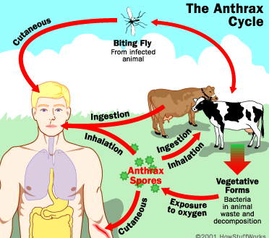
The Life Cycle of Anthrax
http://science.howstuffworks.com/anthrax1.htm

Slide 13
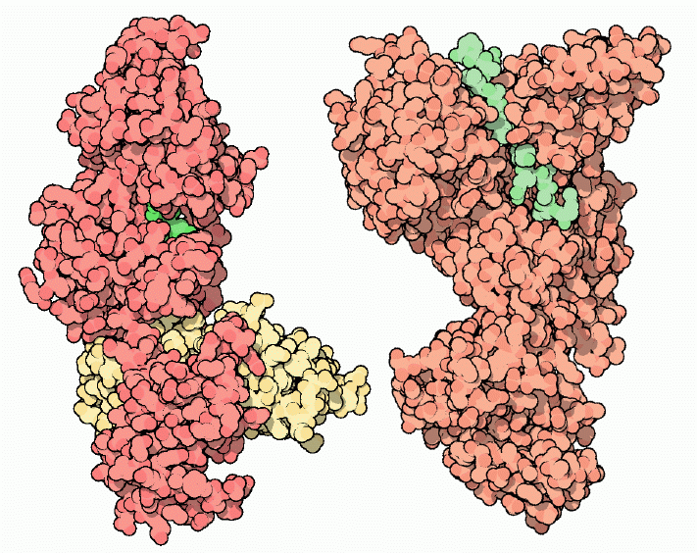
Why Anthrax Kills
Surrounding capsule prevents phagocytosis
Protective antigen (PA) combines with other factors to form two toxins
  PA + Edema Factor = Edema Toxin
  PA + Lethal Factor = Lethal Toxin
Together, these two toxins interfere with cellular functions, causing bleeding, accumulation of fluid in the tissues, and death of cells.
Once symptoms appear, anthrax is very difficult to treat and often results in rapid death.
http://www.rcsb.org/pdb/101/motm.do?momID=28

Slide 14
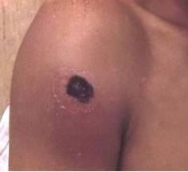
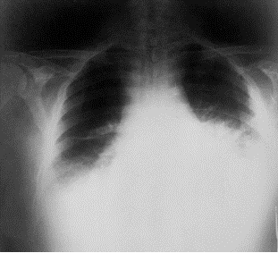
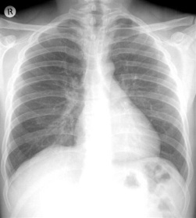
Anthrax as a Weapon
Favoring Use as a Weapon
Available in nature
Spores are very hardy
Can be spread as an aerosol
Is often lethal
Limiting Use as a Weapon
Great skill required to produce weaponized particles
No person-to-person spread
Defenses
Antibiotics
Vaccines
Antitoxins
http://emergency.cdc.gov/agent/anthrax/anthrax-images/
http://www.texascollaborative.org/Puccini%20Module/physiology.php

Slide 15
Yersinia pestis: Plague
Wren BW, Nature Reviews Microbiology 1:55, 2003

Slide 16
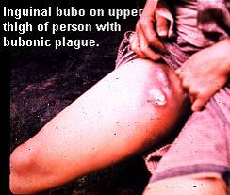
Transmission of Y. pestis
Carried by rats
Spread to people by fleas
Growth in lymph nodes forms buboes (“bubonic plague”)
Can be spread to other people via respiratory droplets
Pneumonic form is the deadliest
Wren BW, Nature Reviews Microbiology 1:55, 2003
http://www.cdc.gov/ncidod/dvbid/plague/p5.htm

Slide 17
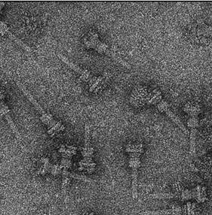
Type III Secretion System of Y. pestis
Macrophage
membrane
Y. pestis can assemble hypodermic-like structures on its surface to inject bacterial proteins into macrophages. These prevent phagocytosis and kill the macrophage.
Y. pestis
outer membrane
Y. pestis
inner membrane
Cornelis GR
Nature Reviews Microbiology 4:811, 2006
Malovits TC et al.
Science 306:1040, 2004

Slide 18
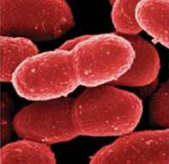
Plague as a Weapon
Favoring Use as a Weapon
Available in nature
Can be spread as an aerosol
Person-to-person spread
Is often lethal if untreated
Limiting Use as a Weapon
Cannot survive long in the environment
Defenses
Antibiotics
Quarantine
Vaccines
http://www.nature.com/nm/journal/v11/n9/fig_tab/nm0905-927_F1.html

Slide 19
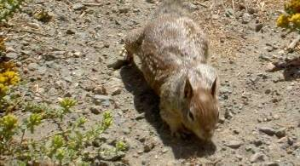
Francisella tularensis: Tularemia
First isolated in 1911 in Tulare County, CA
Found in many small mammals and birds
Spread to people by bites of insects or handling of infected carcasses
No documented spread between people
Courtesy of H. Gil

Slide 20
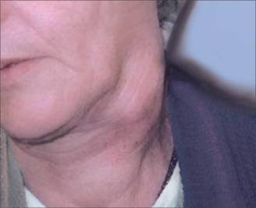
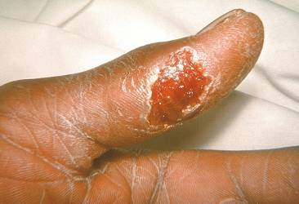
Tularemia
Flu-like illness
Inhalation can cause severe pneumonia with up to 30% mortality if untreated
Death rate less than 1% in treated patients
www.zkea.com/archives/archive02009.html
www.medscape.com/viewprogram/2373_pnt

Slide 21
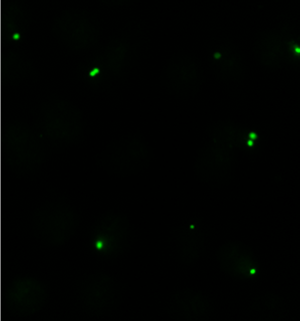
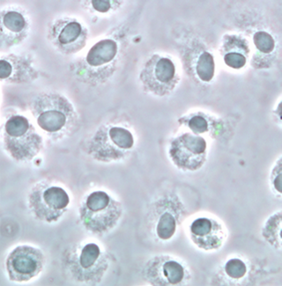
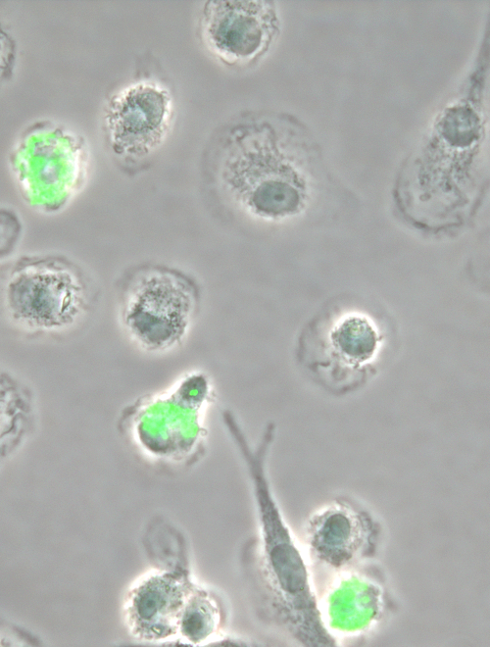
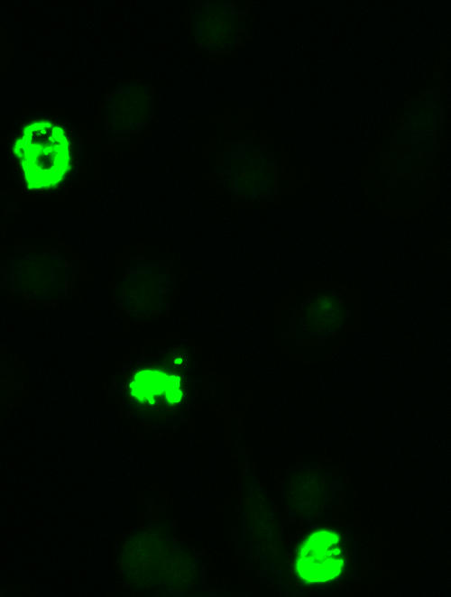
F. tularensis Grows in Macrophages
Within the macrophages, the bacteria are shielded from antibodies and other components of host defense.

Slide 22
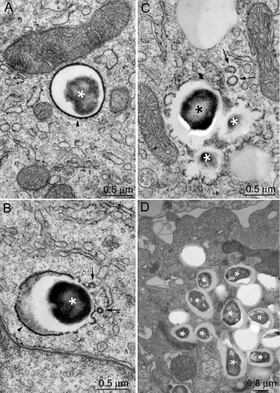
F. tularensis Escapes from the Phagosome
0 h
6 h
Lysosome
3 h
14 h
Phagosome
Clemens DL, Infection and Immunity 72:3205, 2004

Slide 23
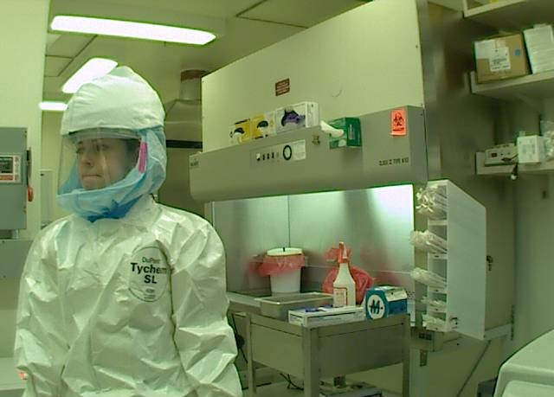
Tularemia as a Weapon
Favoring Use as a Weapon
Available
Can be spread as an aerosol
Somewhat hardy
Highly infectious
Can be lethal if untreated
Limiting Use as a Weapon
No person-to-person spread
Responds to treatment relatively well
Defenses
Antibiotics
Vaccines

Slide 24

Clostridium botulinum: Botulism
Grows only when oxygen level is low
Forms hardy spores that persist in soil
Produces a toxin that is the most potent poison known
Naturally occurring cases are often due to improper processing of canned foods
Botulinum toxin is the only Tier 1 agent that is approved by the Food and Drug Administration!
http://www.botox.co.in/administering.htm

Slide 25
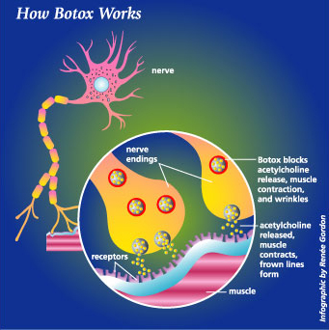
Botulinum Toxin Causes Paralysis
The toxin prevents nerves from releasing acetylcholine, a chemical signal that causes muscle cells to contract.
http://www.fda.gov/fdac/features/2002/402_botox.html

Slide 26
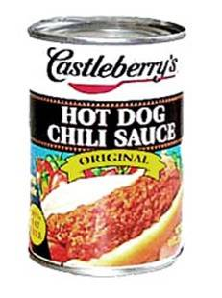
Botulinum Toxin as a Weapon
Favoring Use as a Weapon
Available in nature
Can be spread as an aerosol
Potential spread in food or water
Highly lethal
Limiting Use as a Weapon
Not contagious
Production takes much skill
Broken down by heat and sunlight
Defenses
Antitoxins
Vaccines
Long-term supportive care
Iraq admitted to producing three times the amount of botulinum toxin required to kill the entire human population.
http://i.abcnews.com/US/wireStory?id=3402062

Slide 27
Tier 1 Viruses
Like all viruses, smallpox and the hemorrhagic fever viruses are obligate intracellular parasites. To replicate, they require the synthetic machinery of the host cells that they invade.
RNA or DNA core
Capsid
Envelope
Viral protein

Slide 28
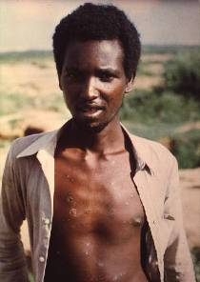
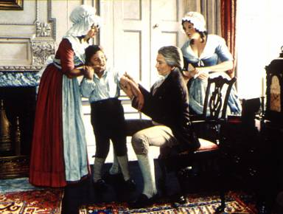
Variola:
Smallpox
Cause of epidemics throughout history of man
Infects only humans
Target of first vaccine, developed by Edward Jenner
Last known case in 1977
Officially exists in only two repositories
  Centers for Disease Control and Prevention (US)
  State Research Center for Virology and Biotechnology (Russia)
http://www.aapa.org/clinissues/BTtables.htm
http://www.personal.psu.edu/jel5/micro/art.htm

Slide 29
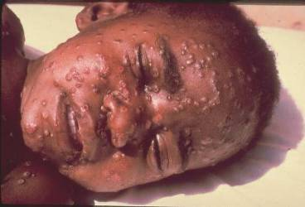
Smallpox
Grows in cells lining the respiratory tract
Spread by coughing
Highly infectious
Mortality rate of about 30%
Unvaccinated population is vulnerable
http://www.aapa.org/clinissues/BTtables.htm

Slide 30
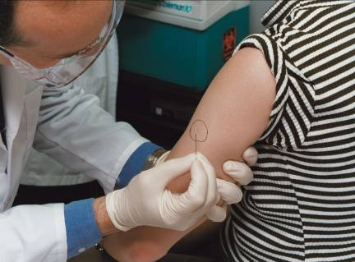
Smallpox as a Weapon
Favoring Use as a Weapon
Can be spread as an aerosol
Highly infectious
High lethality
No treatments
Person-to-person spread
Limiting Use as a Weapon
Availability severely limited
Skill required for culture
Control of spread is difficult
Defenses
Vaccines
Quarantine
Supportive care
http://www3.niaid.nih.gov/topics/BiodefenseRelated/Biodefense/PublicMedia/image_library.htm

Slide 31
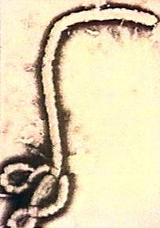
Ebola and Marburg Viruses
Filoviruses
Cause hemorrhagic fevers
None occur naturally in the US
Carried by animals
Transmitted to people accidentally
Easily spread to other people by bodily fluids
Ebola virus
http://www.cnn.com/HEALTH/9604/16/nfm/ebola.levine/index.html

Slide 32
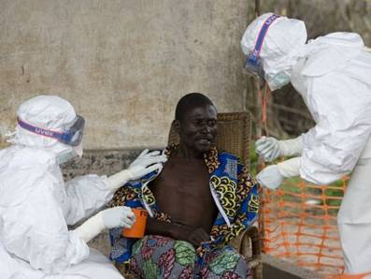
Pathology of Viral
Hemorrhagic Fevers
High fatality rates
Cause bleeding
  Low levels of platelets
  Damage to cells of the blood vessels?
  Changes in the function of the blood clotting system?
Failure of multiple organ systems
Kampungu, Congo
September 29, 2007
http://abcnews.go.com/Health/wireStory?id=3681171

Slide 33
Hemorrhagic Fever Viruses as Weapons
Favoring Use as a Weapon
Available in nature
Highly infectious
High lethality
Few treatments
Person-to-person spread
Limiting Use as a Weapon
Skill required for culture
Control of spread is difficult
Defenses
Ribavirin
Supportive care
Quarantine
http://www.cdc.gov/ncidod/dvrd/spb/mnpages/icposters/

Slide 34
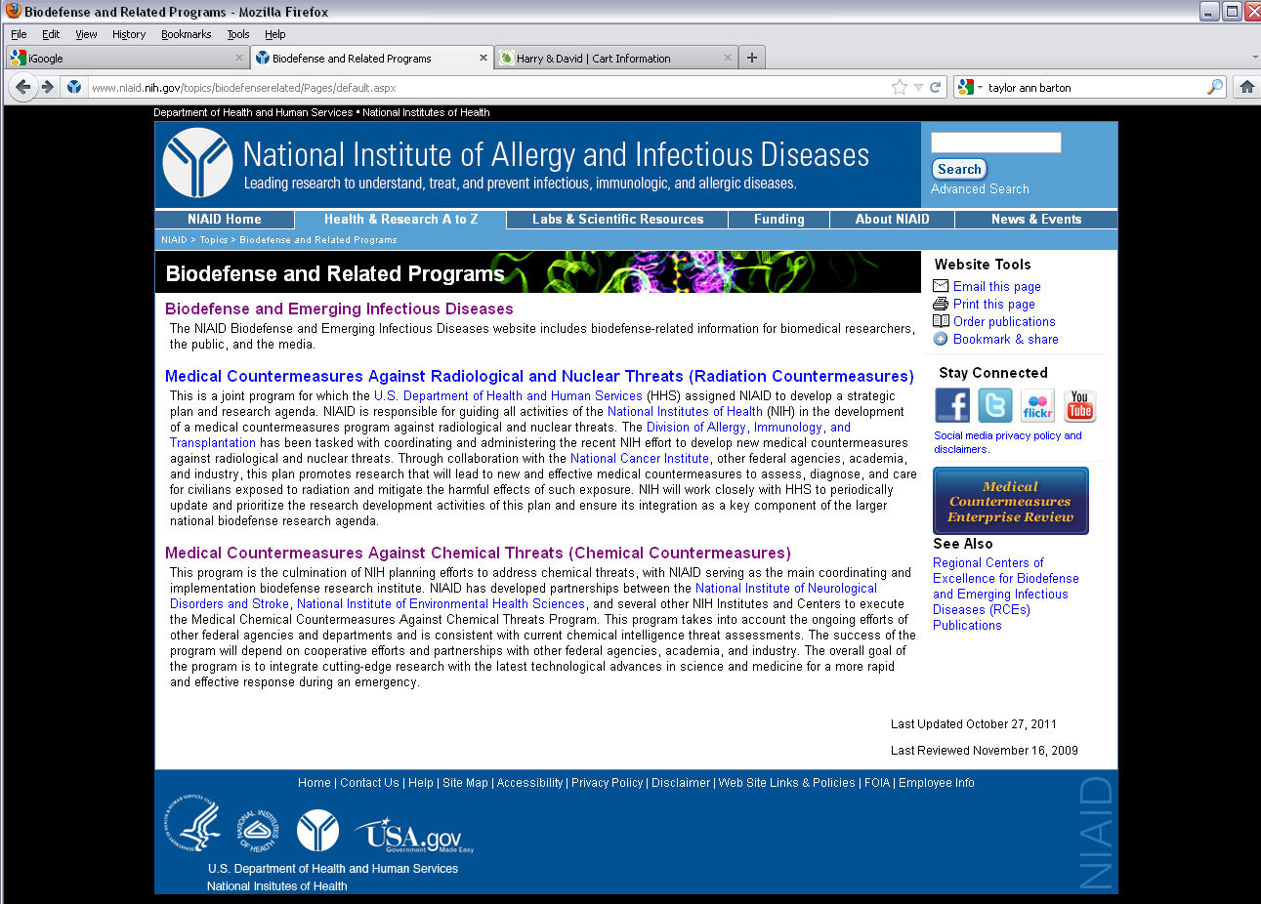
US Biodefense Programs http://www3.niaid.nih.gov/topics/BiodefenseRelated/

